Slide 1

rgupta.mtech@gmail.com Java Training Hibernate
HIBERNATE 5.0
Rajeev Gupta M. Tech CS
Java Trainer & Consultant

Slide 2

Workshop topics
❖
❖
❖
❖
❖
❖
❖
❖
❖
Hibernate-What it is ?
❖ HQL and the Query Object
JPA- What it is?
❖ one class to two tables
❖ Select and Pagination in HQL
ORM and Issues
Hibernate Hello World CRUD
Primary key generation strategy
More annotations
❖
Named Quaries
❖ Criteria API
Hibernate Object life cycle
Hibernate Architecture
Relation mapping
❖
Hibernate caching
Hibernate JPA
Many-to-one mapping
Hibernate performance
❖
❖
one-to-one mapping
❖
Many-to-Many mapping
❖
Inheritance in Hibernate
❖
Single Table Strategy
❖
Table Per Class Strategy
❖
Joined Strategy
rgupta.mtech@gmail.com Java Training Hibernate

Slide 3
Workshop topics
❖
❖
❖
❖
❖
❖
❖
❖
❖
Hibernate-What it is ?
❖ HQL and the Query Object
JPA- What it is?
❖ one class to two tables
❖ Select and Pagination in HQL
❖ Named Quaries
ORM and Issues
Hibernate Hello World CRUD
Primary key generation strategy
More annotations
❖
Criteria API
Hibernate Object life cycle
Hibernate Architecture
Relation mapping
❖ Hibernate caching
❖ First Level
❖ Second Level Cache
❖ Hibernate optimization
❖ Hibernate Batch Processing
❖
Many-to-one mapping
❖
one-to-one mapping
❖
Many-to-Many mapping
❖
Inheritance in Hibernate
❖
Single Table Strategy
❖
Table Per Class Strategy
❖
Joined Strategy
rgupta.mtech@gmail.com Java Training Hibernate

Slide 4


Slide 5
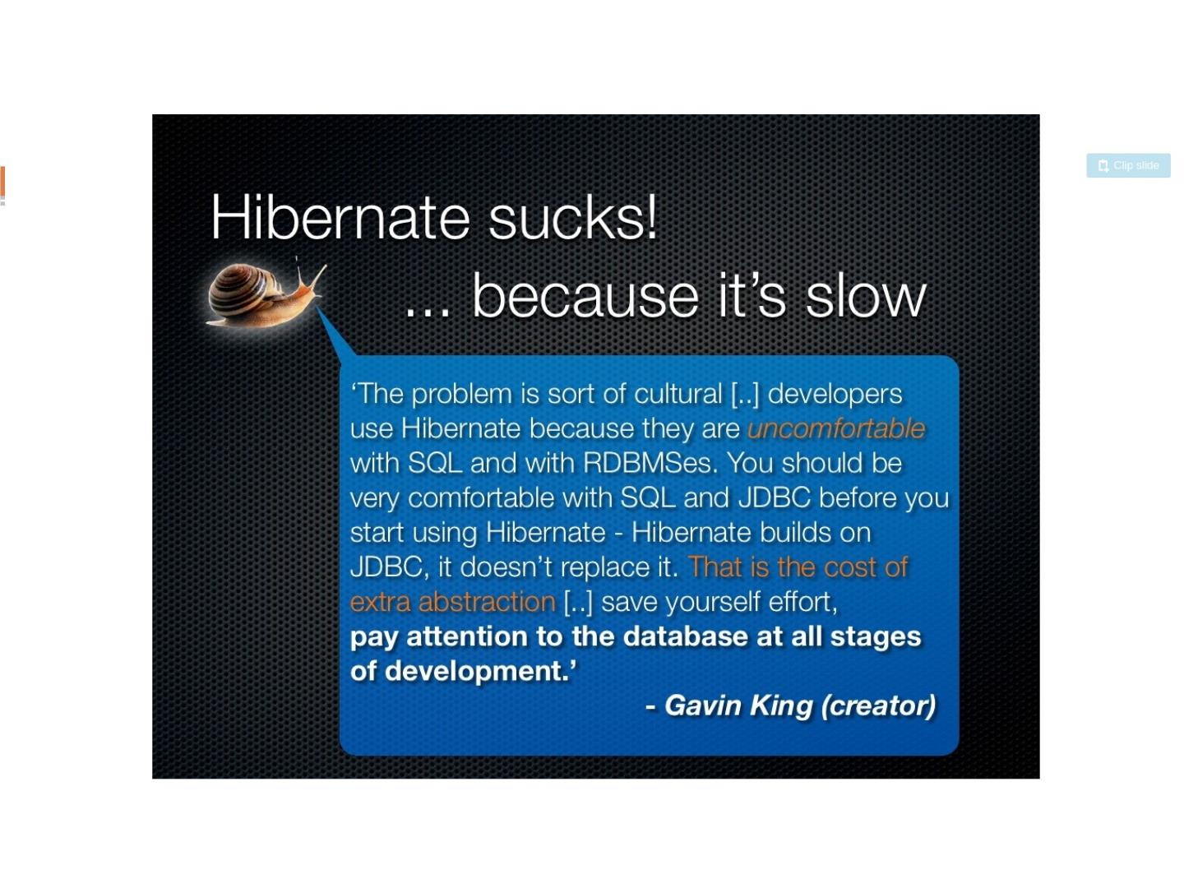

Slide 6
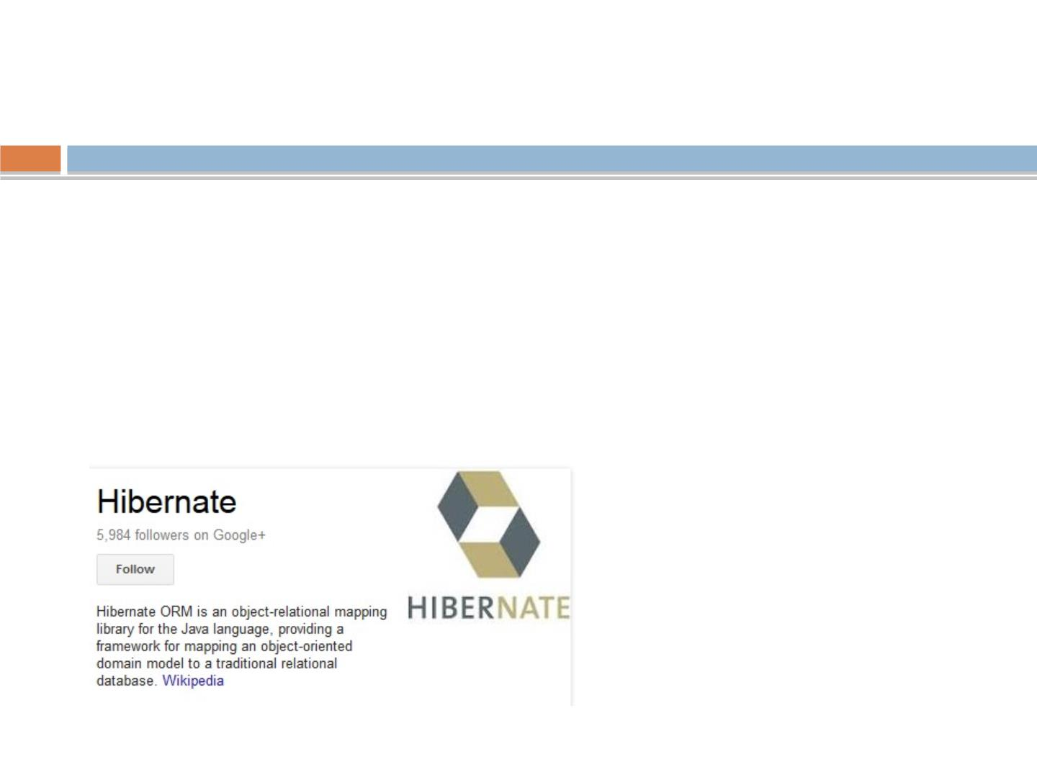
What is Hibernate?
•
Hibernate is an ORM (Object Relational Mapping) tool.
•
Maps the Relational Model in the database to the Object
Model in Java.
•
Tables are mapped to classes.
•
Columns are mapped to JavaBean properties.
•
Replaces SQL with HQL, a database-independent query
language that navigates object relations rather than table
rgupta.mtech@gmail.com Java Training Hibernate

Slide 7
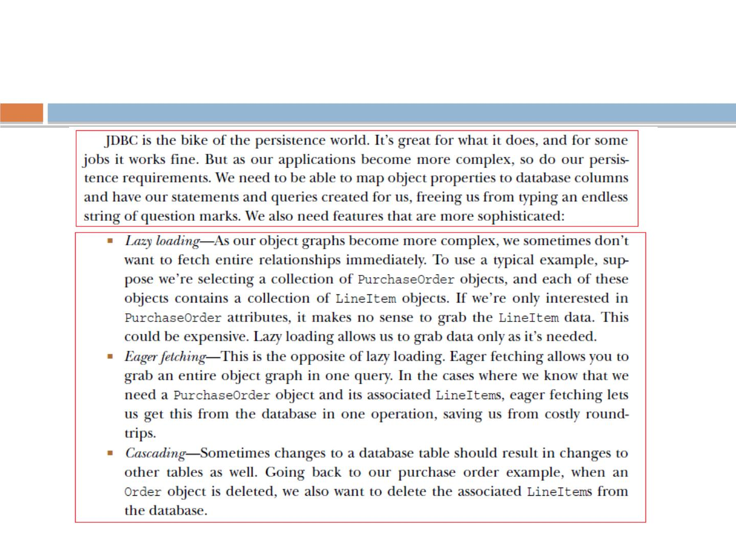
Why Hibernate?
rgupta.mtech@gmail.com Java Training Hibernate

Slide 8
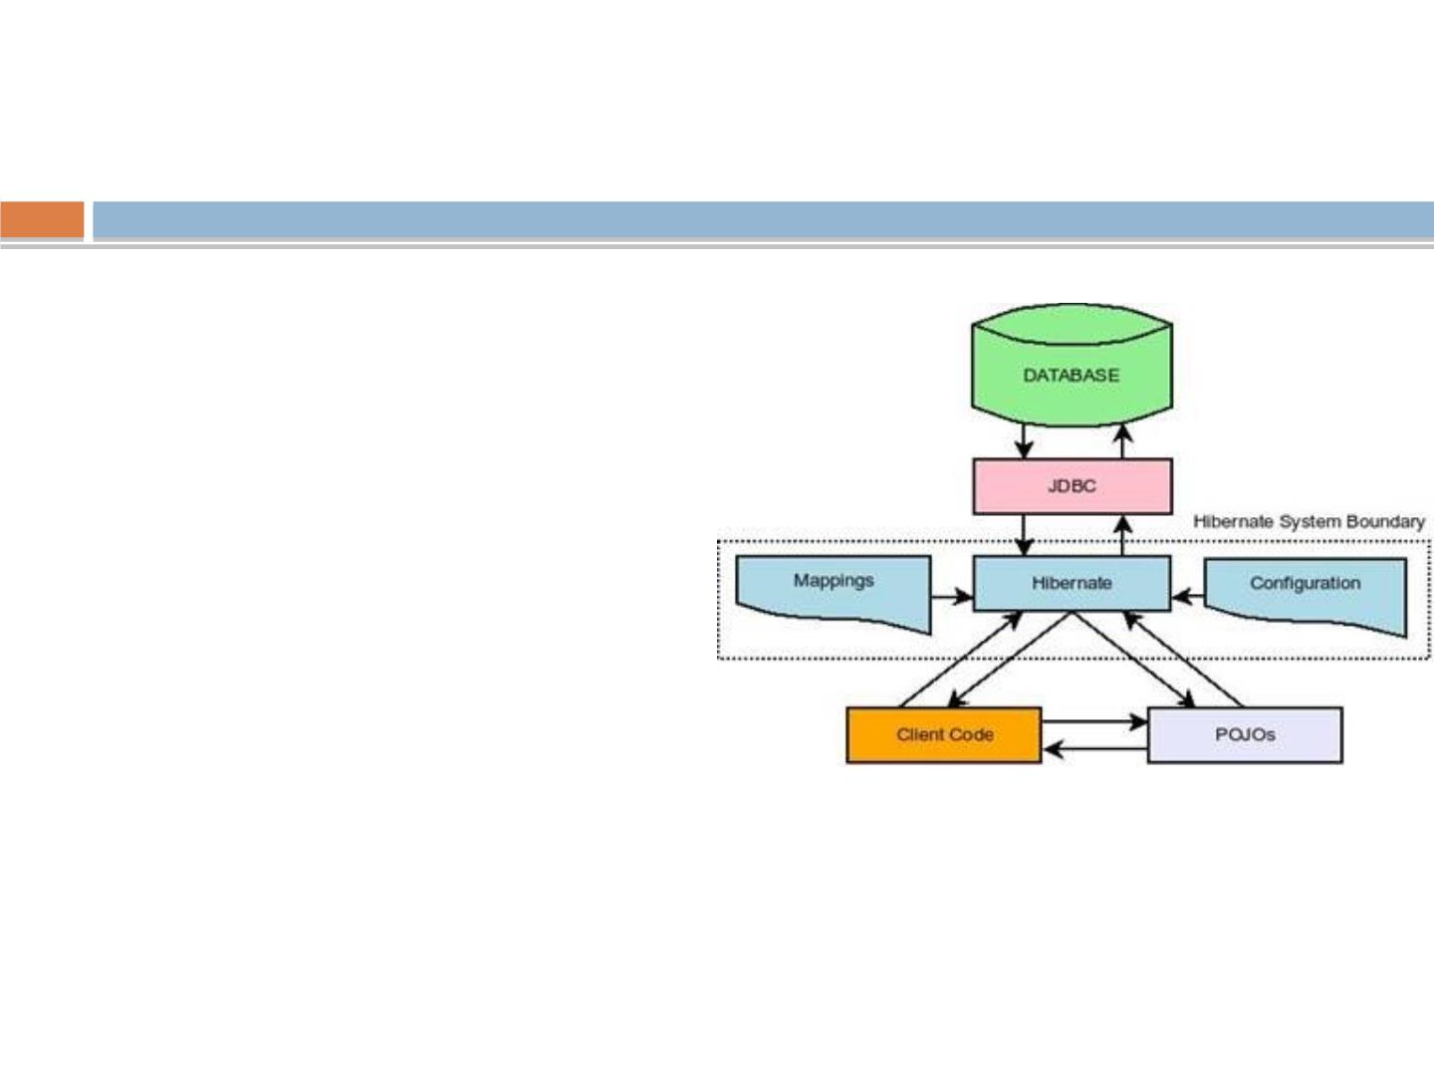
If ORM is the Solution, is JDBC
a Problem?
◻
No, no, JDBC is perfectly alright
◻
ORM provides a layer of
convenience for the
programmer.
◻
Does this convenience come
with a price of performance?
◻
ORM sits in between your
application and JDBC providing
the missing link between the
object oriented model and
relational database model of
programming. In fact this so
called ORM interacts with the
JDBC to talk to the database
ultimately.
rgupta.mtech@gmail.com Java Training Hibernate

Slide 9
Workshop topics
❖
Hibernate-What it is ?
❖ HQL and the Query Object
❖
❖
❖
❖
❖
❖
❖
❖
JPA- What it is?
❖ one class to two tables
❖ Select and Pagination in HQL
❖ Named Quaries
ORM and Issues
Hibernate Hello World CRUD
Primary key generation strategy
More annotations
❖
Criteria API
Hibernate Object life cycle
Hibernate Architecture
Relation mapping
❖ Hibernate caching
❖ First Level
❖ Second Level Cache
❖ Hibernate optimization
❖ Hibernate Batch Processing
❖
Many-to-one mapping
❖
one-to-one mapping
❖
Many-to-Many mapping
❖
Inheritance in Hibernate
❖
Single Table Strategy
❖
Table Per Class Strategy
❖
Joined Strategy
rgupta.mtech@gmail.com Java Training Hibernate

Slide 10
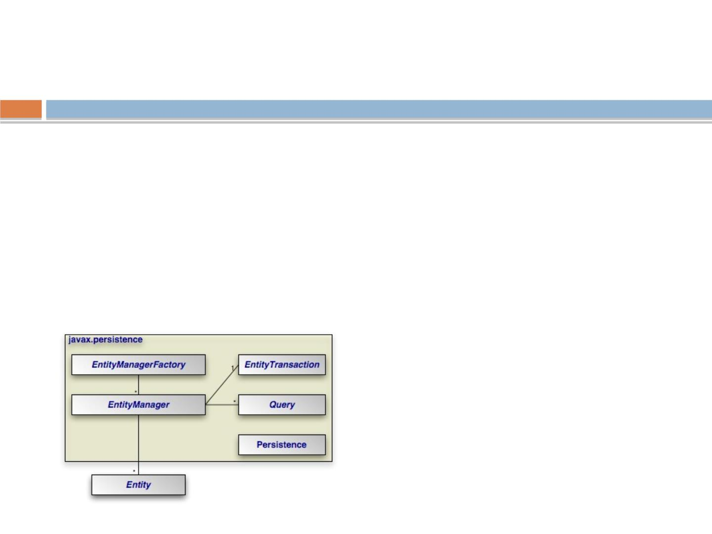
What is JPA?
•
J PA is the Java Persistence API, the entity persistence model for
EJB 3.0
•
Standardized persistence framework which is implemented by
Hibernate (or TopLink, Cayenne, etc.)
•
J PA Annotations and persistence.xml provide vendor independent
conﬁguration
•
EntityManager provides vendor independent access to persistence
•
Replaces vendor speciﬁc query languages (HQL) with standard
rgupta.mtech@gmail.com Java Training Hibernate

Slide 11
Why JPA?
•
JPA is the standard, and standards are good!
•
Using JPA does not tie you to Hibernate.
•
JPA gives you most of the features of plain old Hibernate,
except:
–
No criteria queries in J PA 2.0 ☹
•
Criteria query is a neat feature of Hibernate that constructs query
using Java-based combinators instead of alternate query language,
getting the beneﬁt of IntelliSense and Eclipse’s refactoring tools.
–
–
JPA doesn’t have Hibernate’s DeleteOrphan cascade type
•
Delete Orphan is a useful annotation that directs Hibernate to deletes
entities in a collection if the parent is deleted, preventing orphaning.
JPA doesn’t have an equivalent to Hibernate’s ScrollableResults
•
But, all of these features are accessible to an otherwise
fully JPA application!
rgupta.mtech@gmail.com Java Training Hibernate

Slide 12
Workshop topics
❖
❖
Hibernate-What it is ?
❖ HQL and the Query Object
JPA- What it is?
❖ one class to two tables
❖ Select and Pagination in HQL
❖ Named Quaries
❖
❖
❖
❖
❖
❖
❖
ORM and Issues
Hibernate Hello World CRUD
Primary key generation strategy
More annotations
❖
Criteria API
Hibernate Object life cycle
Hibernate Architecture
Relation mapping
❖ Hibernate caching
❖ First Level
❖ Second Level Cache
❖ Hibernate optimization
❖ Hibernate Batch Processing
❖
Many-to-one mapping
❖
one-to-one mapping
❖
Many-to-Many mapping
❖
Inheritance in Hibernate
❖
Single Table Strategy
❖
Table Per Class Strategy
❖
Joined Strategy
rgupta.mtech@gmail.com Java Training Hibernate

Slide 13
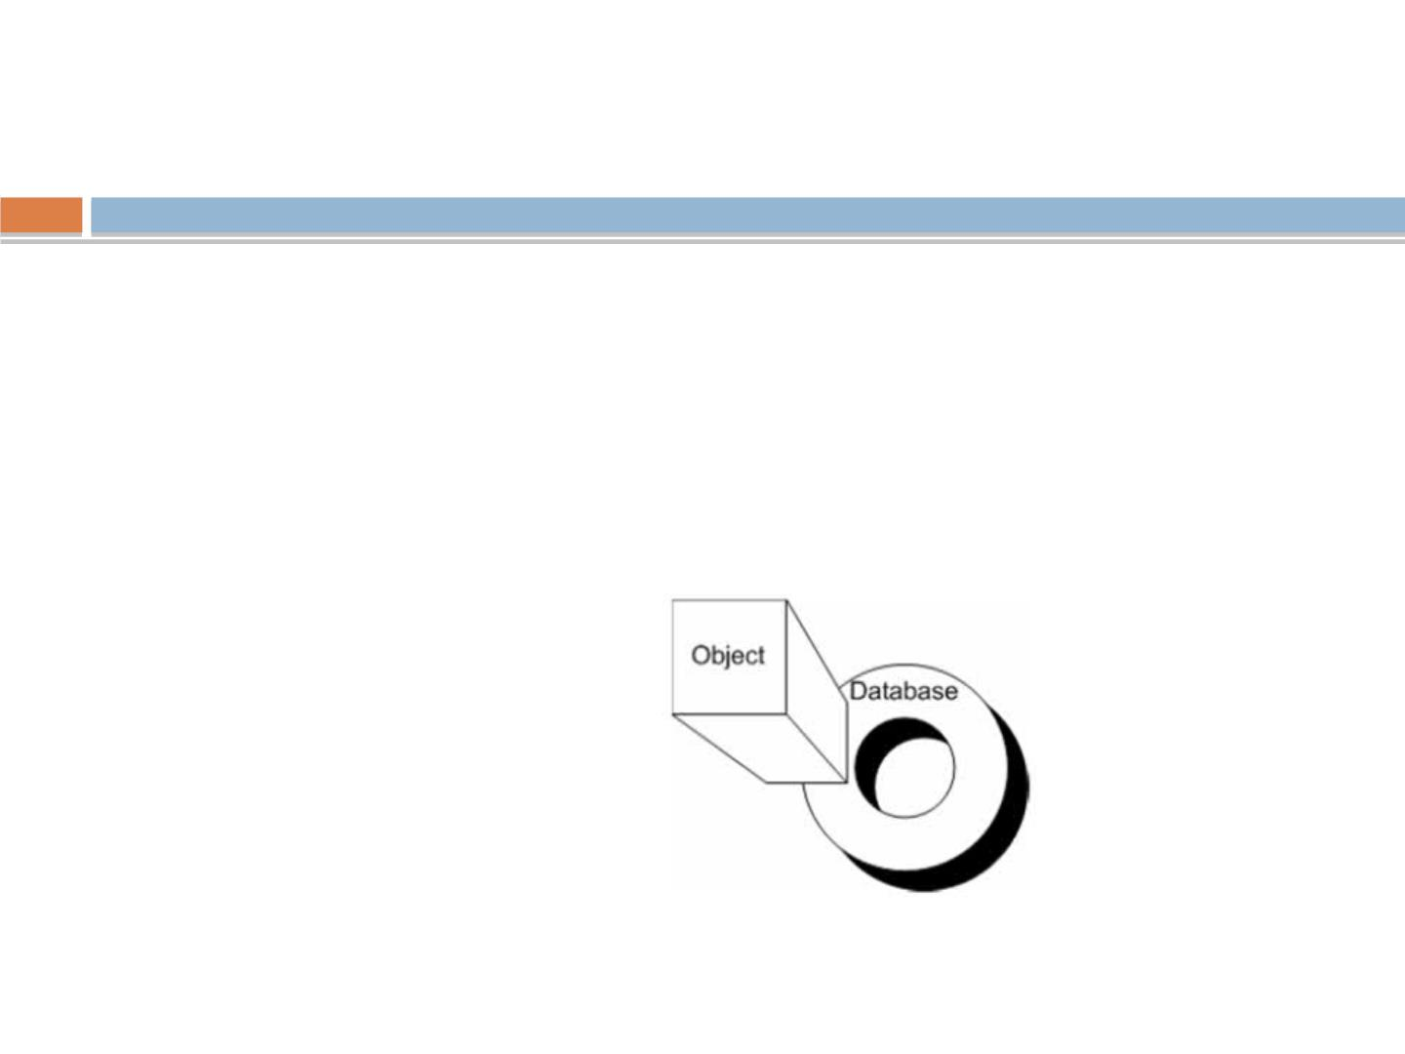
ORM
◻Object ←←Relational
◻
Mapping object to relational world is not easy, as there are points of
mismatches
◻
There are numbers of impedance mismatches between OO world and
DB worlds, and ORM tool must address and provide solutions for that
❑
Identity
❑
Granularity
❑
Associations
❑
Navigation
❑
Inheritance
❑
Data type mismatch
rgupta.mtech@gmail.com Java Training Hibernate

Slide 14
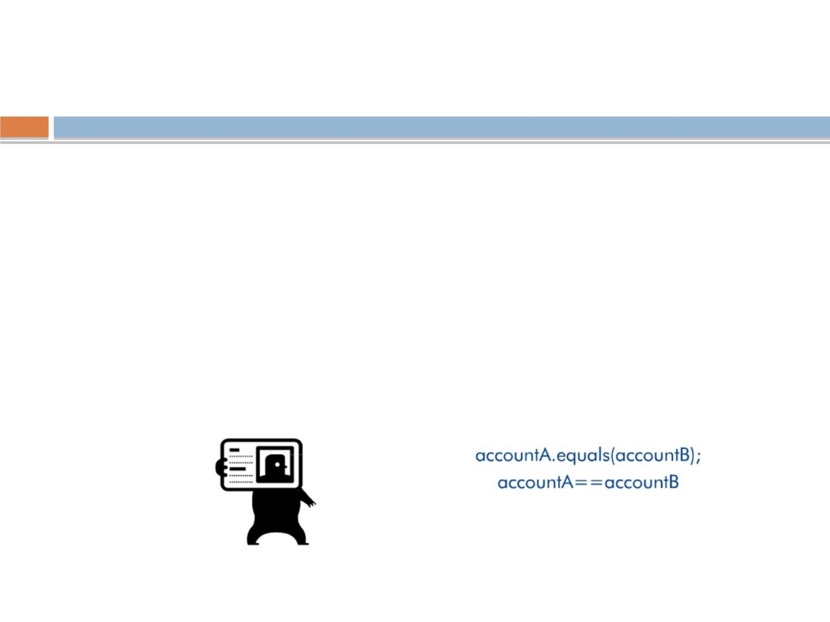
Identity
◻
A row is uniquely identiﬁed form all other rows by
its primary key
◻
An object's identity does not always translate
well to the concept of primary key of DB world
◻
In Java, What is the meaning of identity of an
object?
◻
Its data or its place in memory?
rgupta.mtech@gmail.com Java Training Hibernate

Slide 15
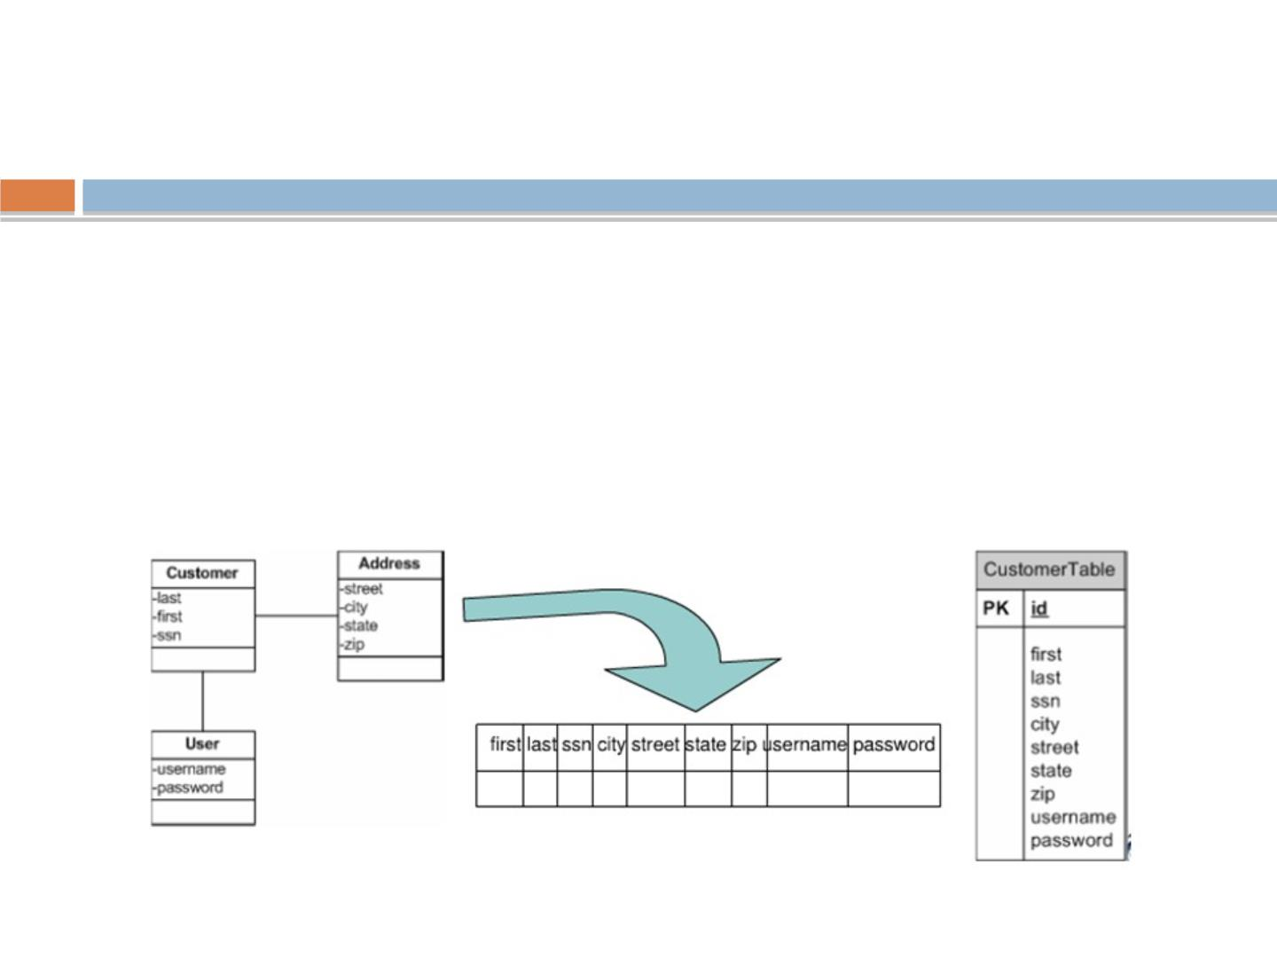
Granularity
◻
Objects and tables are at diﬀerent levels of
granularity
◻
Table structure are often de-normalized in order
to support better performance, so table rows can
map to multiple objects, how to map them?
rgupta.mtech@gmail.com Java Training Hibernate

Slide 16
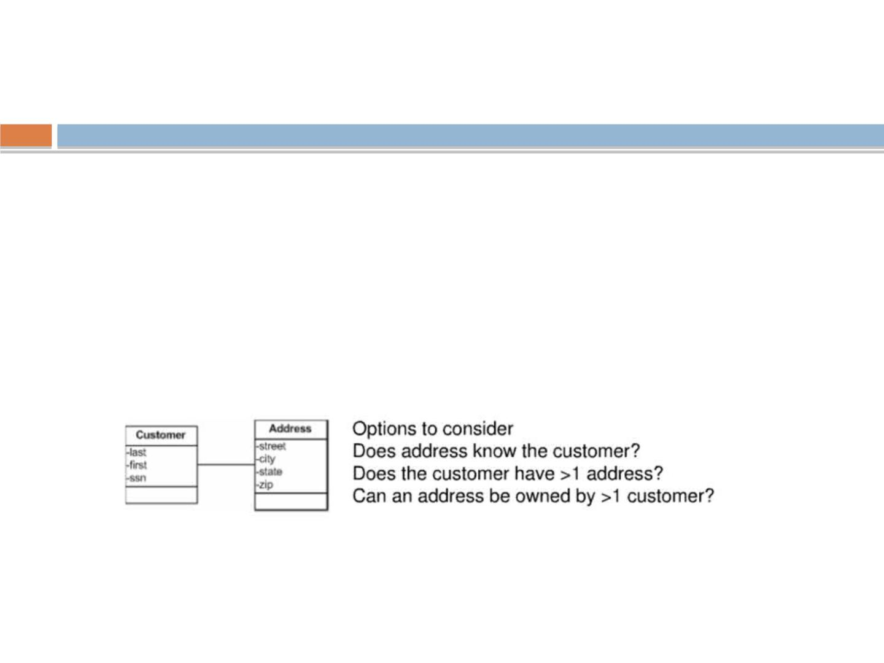
Associations
◻
Associations in Java are either unidirectional or
bidirectional and can be represented by one
object having pointer of other object.
◻
Relation between database tables is based on
join. table relationship is always bidirectional,
while for object it may be
unidirectional/bidirectional
rgupta.mtech@gmail.com Java Training Hibernate

Slide 17
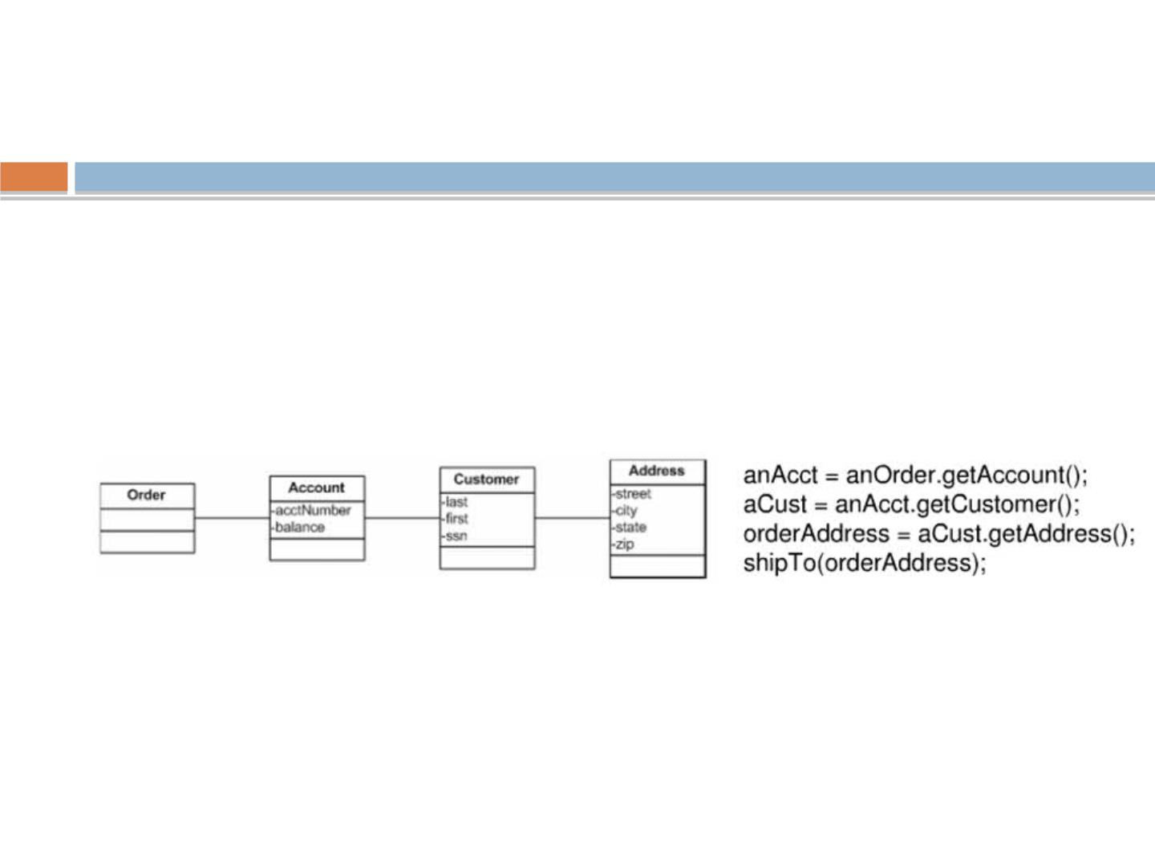
Navigation and associations traversal
◻
Navigating Java Objects to get property information
often require traversal of the object graph.
◉
This can be quite expensive if the objects are
distributed or need to be created before traversed.
◉
Consider getting the address to ship and order
◻
While navigation in database is handled with the
help of single join.
rgupta.mtech@gmail.com Java Training Hibernate

Slide 18
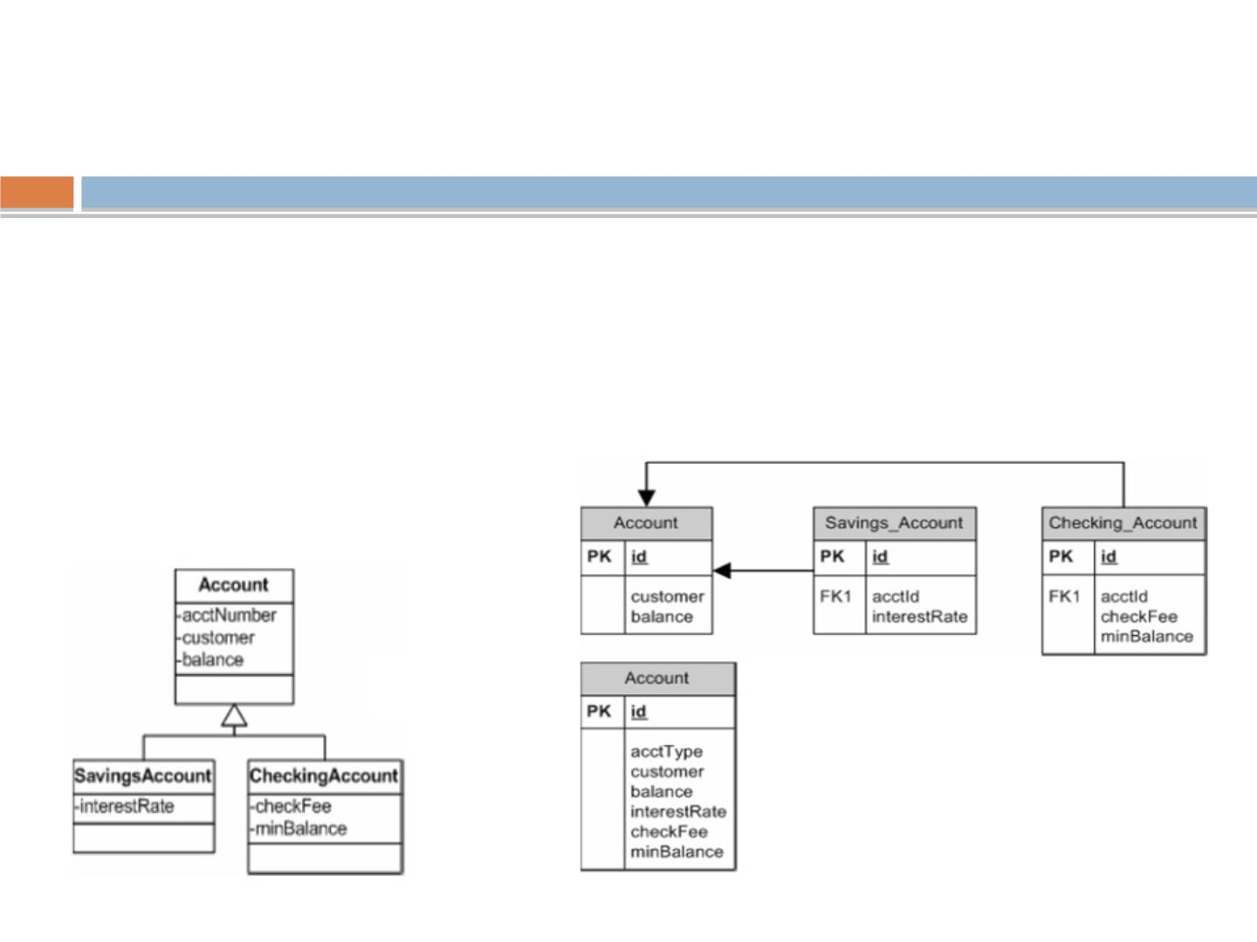
Inheritance
◻
Inheritance and Polymorphism are important concepts in
OO world
◻
Database don't have equivalent concepts
◻
Now question is how to map it to database world?
Inheritance examples
rgupta.mtech@gmail.com Java Training Hibernate

Slide 19
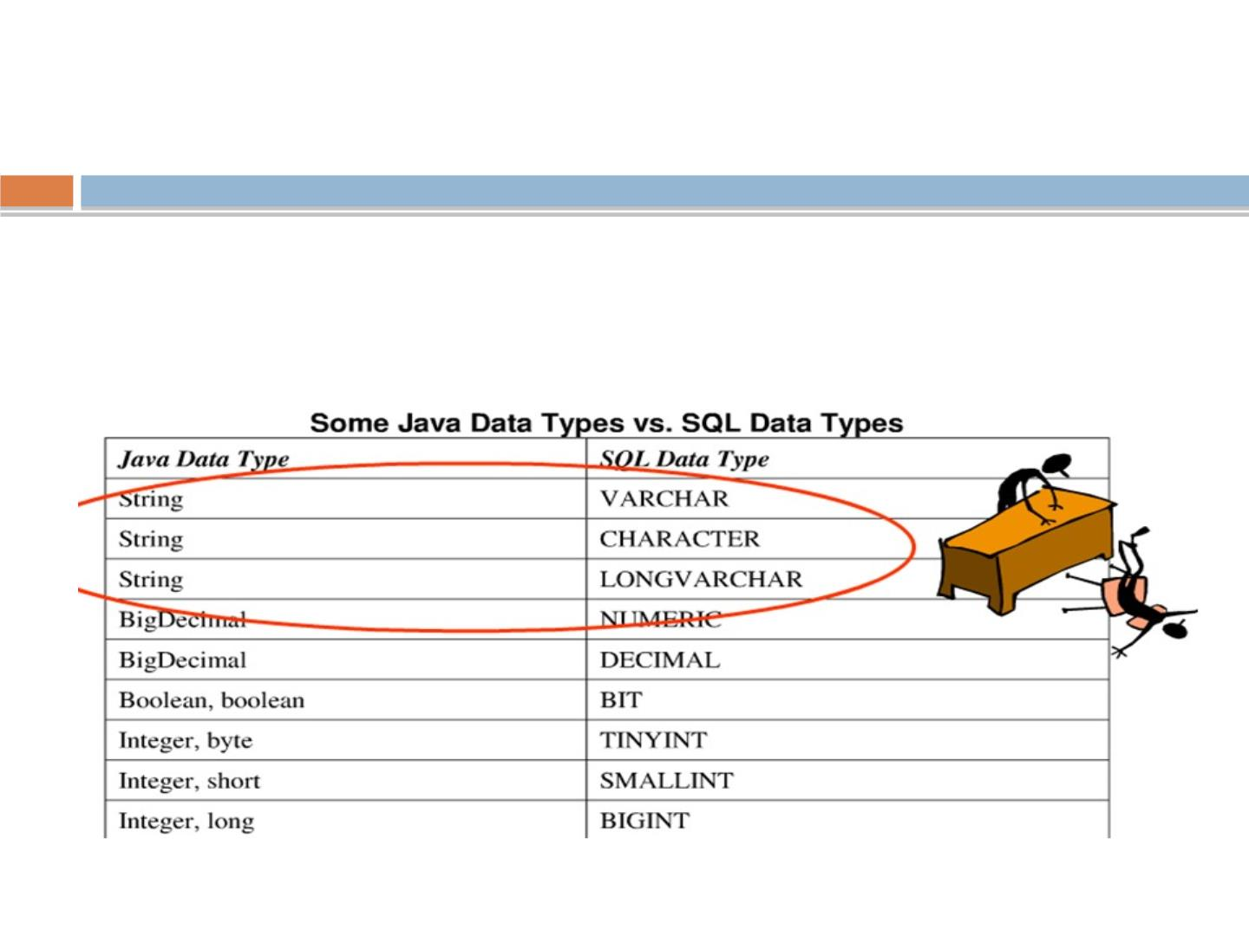
Data Types
◻
There is mismatch between database data type and object
oriented data types.
◻
Question is how ORM tools can help us to map is correctly?
rgupta.mtech@gmail.com Java Training Hibernate

Slide 20
Workshop topics
❖
❖
❖
Hibernate-What it is ?
❖ HQL and the Query Object
JPA- What it is?
❖ one class to two tables
❖ Select and Pagination in HQL
ORM and Issues
❖
❖
❖
❖
❖
❖
Hibernate Hello World CRUD
Primary key generation strategy
More annotations
❖
❖
Named Quaries
Criteria API
Hibernate Object life cycle
Hibernate Architecture
Relation mapping
❖ Hibernate caching
❖ First Level
❖ Second Level Cache
❖ Hibernate optimization
❖ Hibernate Batch Processing
❖
Many-to-one mapping
❖
one-to-one mapping
❖
Many-to-Many mapping
❖
Inheritance in Hibernate
❖
Single Table Strategy
❖
Table Per Class Strategy
❖
Joined Strategy
rgupta.mtech@gmail.com Java Training Hibernate

Slide 21
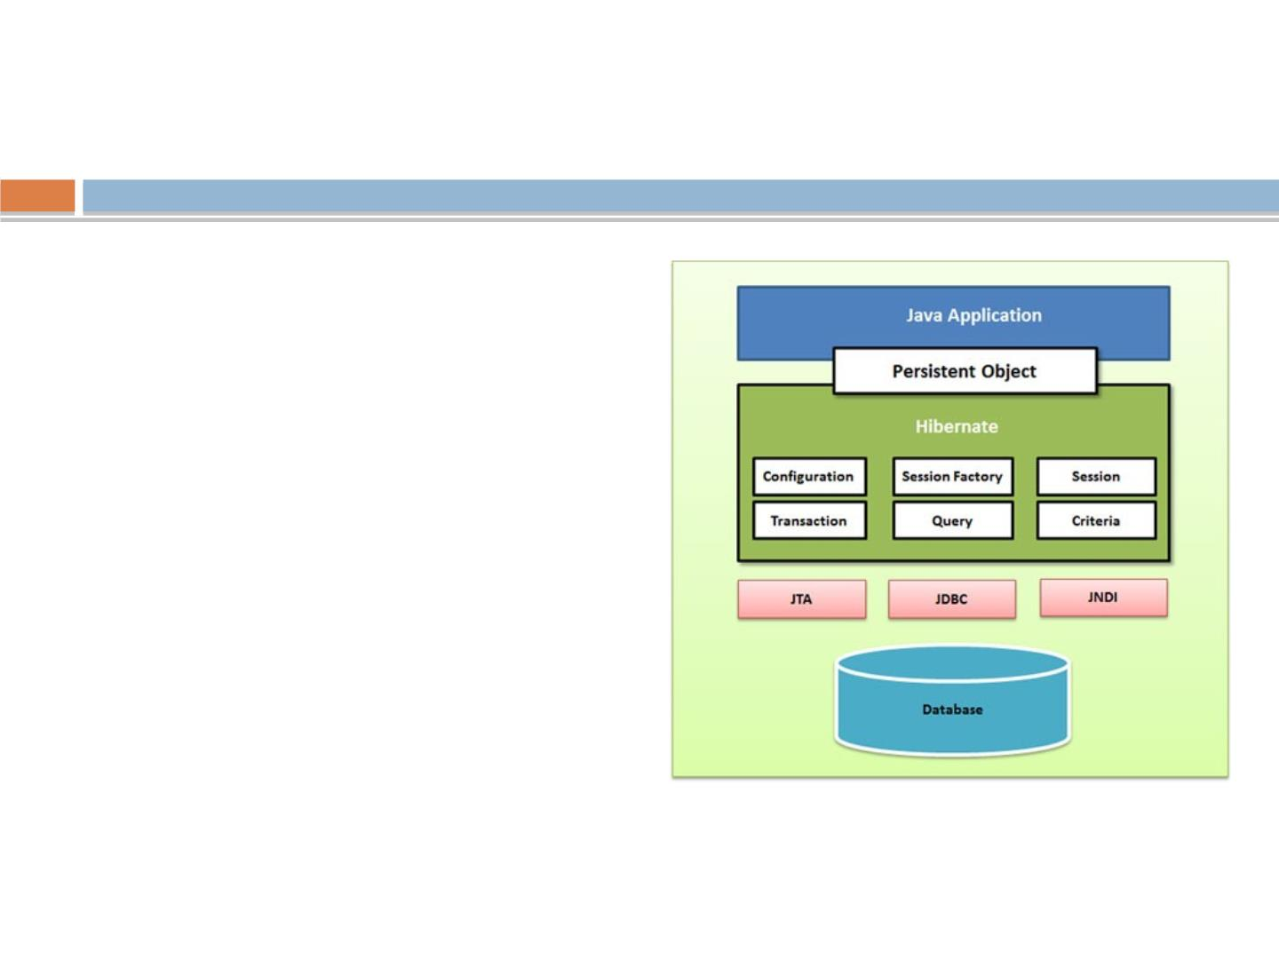
Hibernate Hello World
Steps
1. Write a POJO class
representing the
table
2. Write a hbm ﬁle
3. Write cfg ﬁle/ write
annotated POJO
class
4. Write a class to
test CRUD code
rgupta.mtech@gmail.com Java Training Hibernate

Slide 22
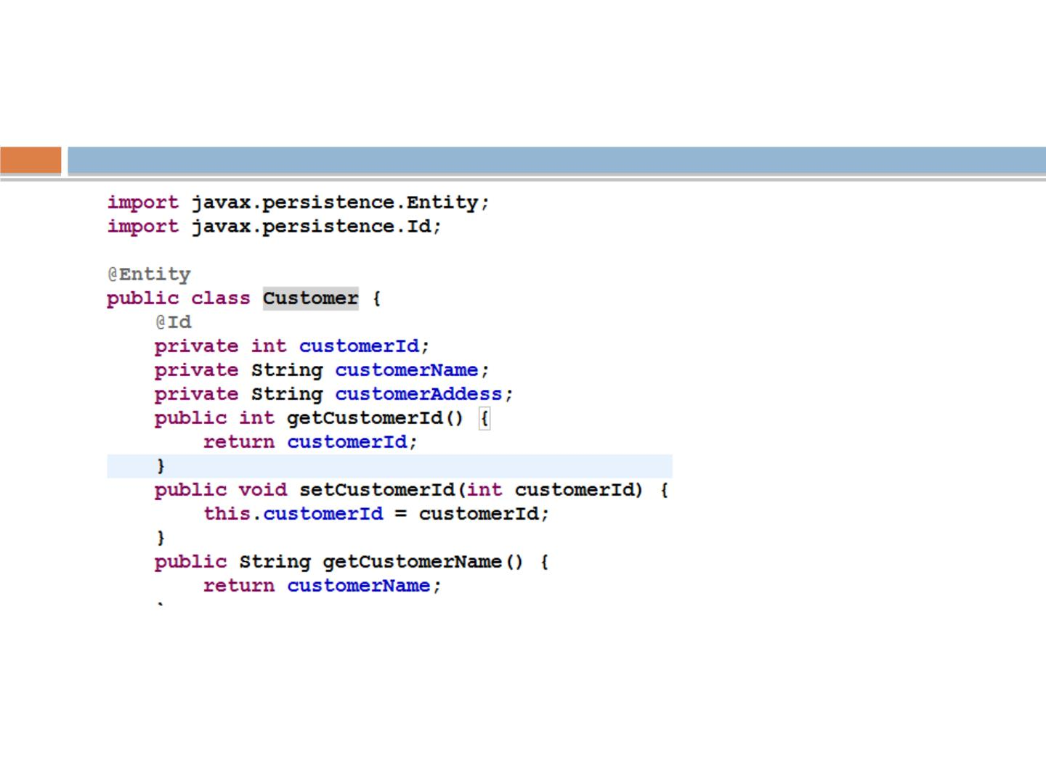
Write a Annotated POJO class
Note: annotations can also be applied to getters
rgupta.mtech@gmail.com Java Training Hibernate

Slide 23

Rule to be Entity
Entity class must be:
1. Annotated with @javax.persistence.Entity
2. @javax.persistence.Id annotation must be used
to denote primary key
3. Must have a no-arg constructor that has to be
public or protected.
4. Must be a top-level class.
5. Entity class must not be ﬁnal.
6. No methods or persistent instance variables of
the entity class may be ﬁnal
7. May implements Serializable interface
rgupta.mtech@gmail.com

Slide 24
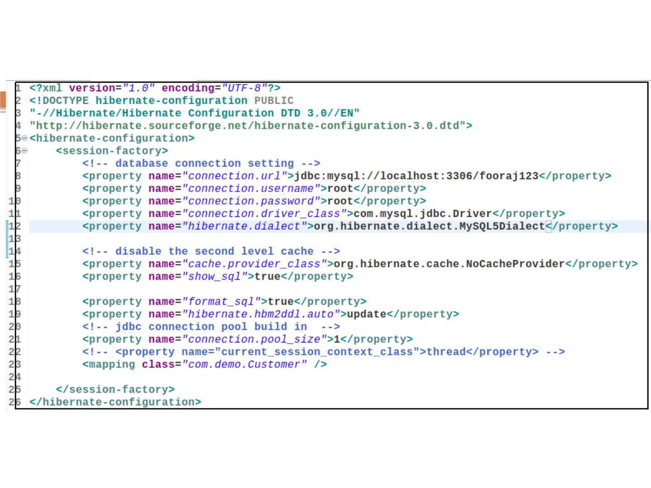
Hibernate.cfg.xml
rgupta.mtech@gmail.com Java Training Hibernate

Slide 25
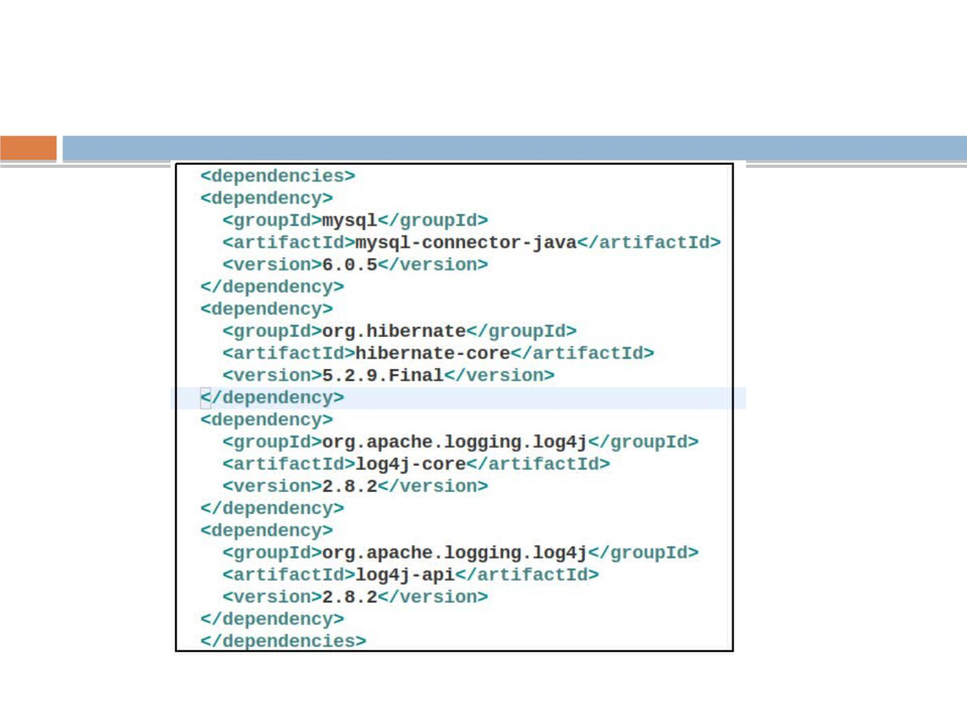
Hibernate Dependencies

Slide 26
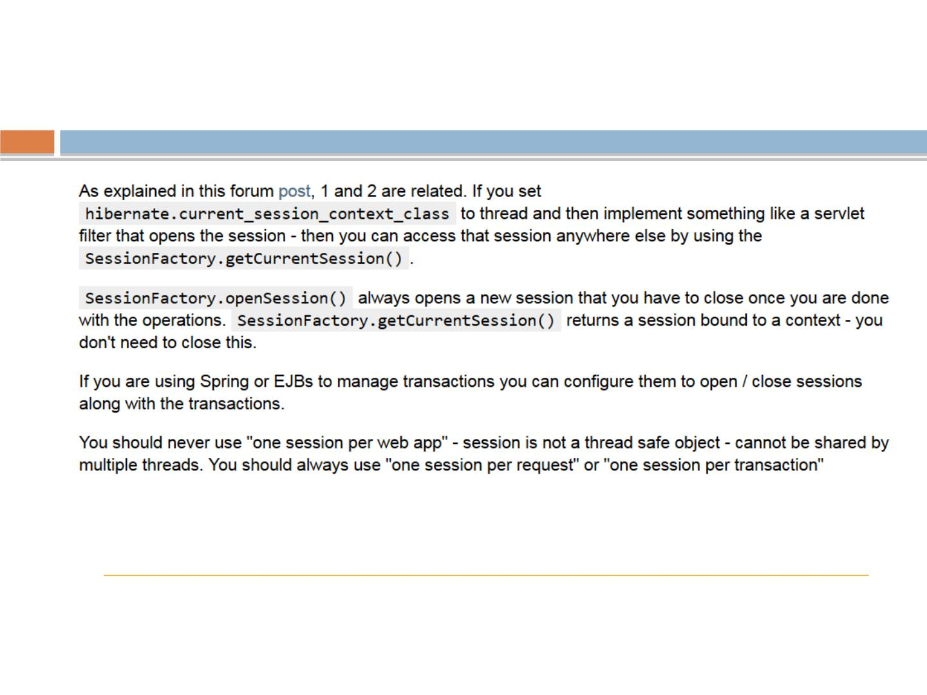
<property
name="current_session_context_class">thread</property>
◻
http://stackoverﬂow.com/questions/8046662/hibernate-opensession-vs-get
currentsession
◻
https://forum.hibernate.org/viewtopic.php?p=2384979&sid=8367751b54bf
160003b867f858393398#p2384979
rgupta.mtech@gmail.com Java Training Hibernate

Slide 27
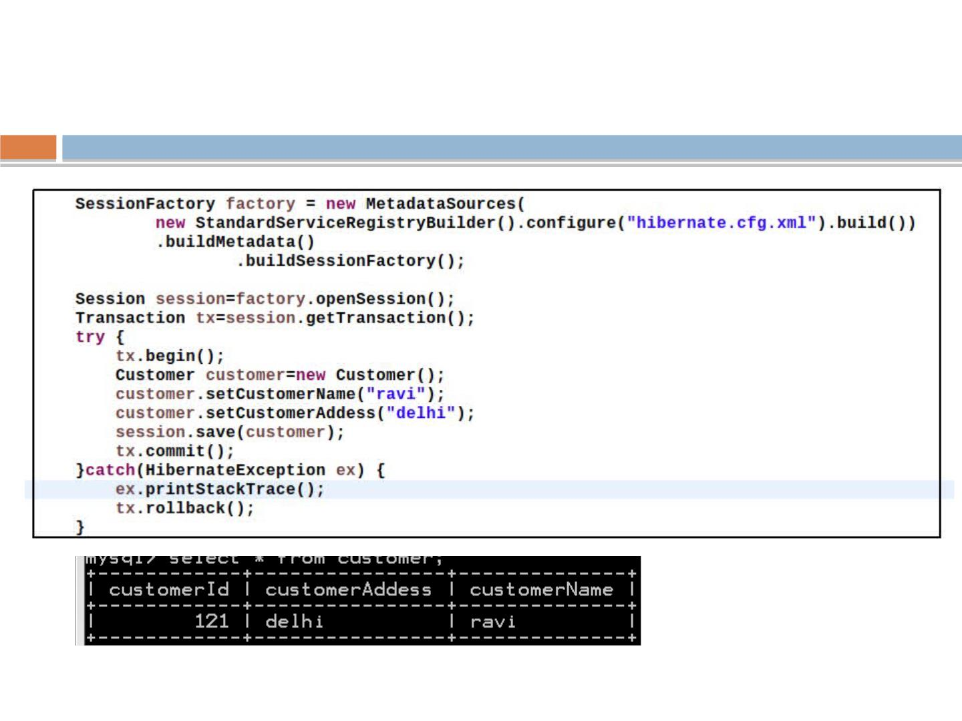
Adding record
rgupta.mtech@gmail.com Java Training Hibernate

Slide 28
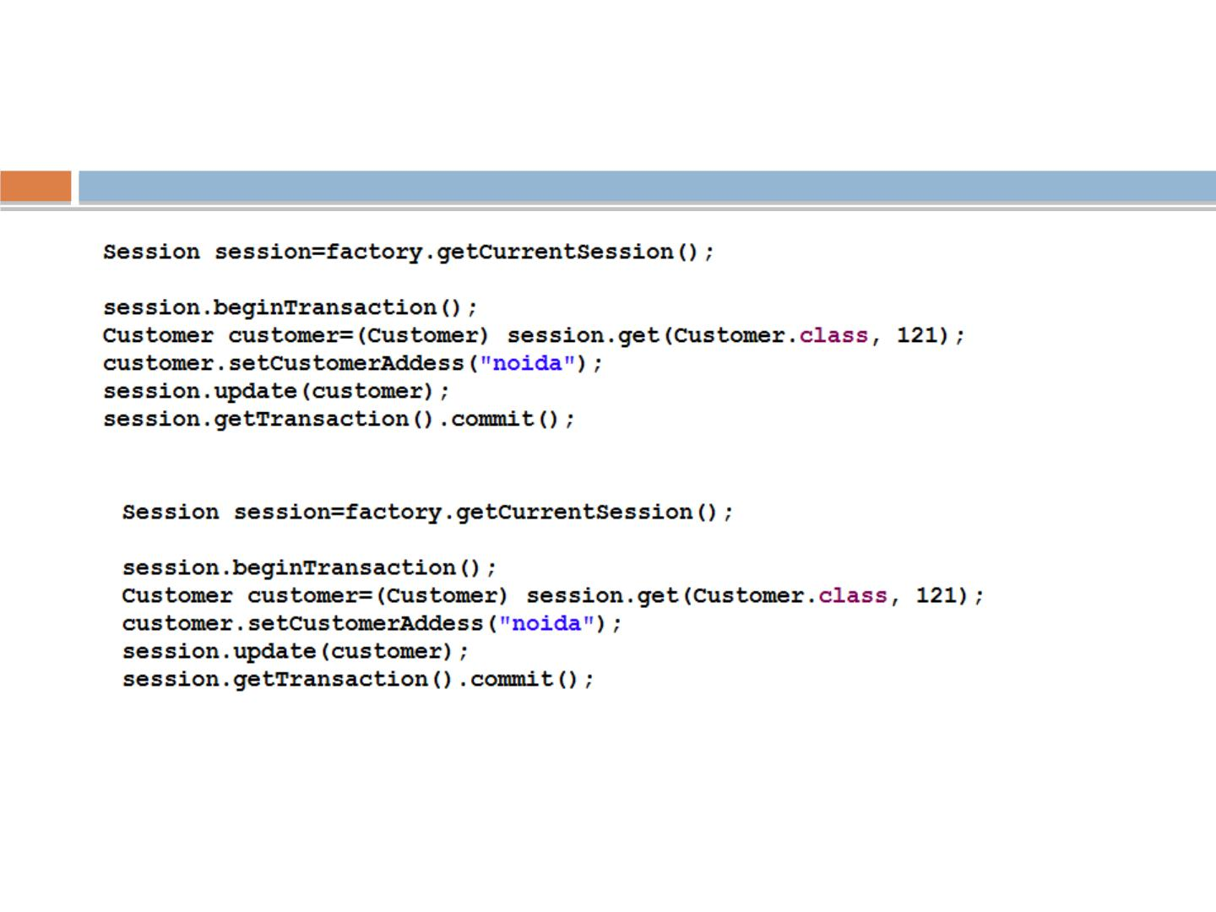
get & Update record
rgupta.mtech@gmail.com Java Training Hibernate

Slide 29
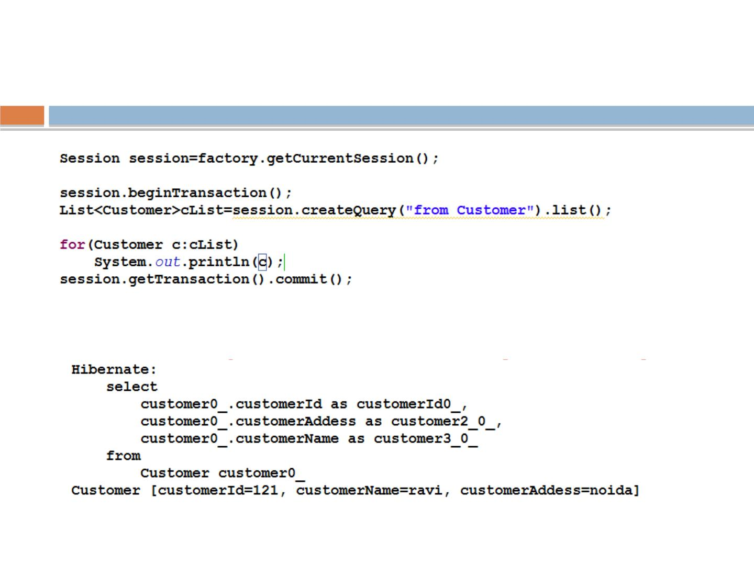
Display all records
rgupta.mtech@gmail.com Java Training Hibernate

Slide 30
Workshop topics
❖
❖
❖
❖
Hibernate-What it is ?
❖ HQL and the Query Object
JPA- What it is?
❖ one class to two tables
❖ Select and Pagination in HQL
ORM and Issues
Hibernate Hello World CRUD
Primary key generation strategy
More annotations
❖
Named Quaries
❖
❖
❖
❖
❖
❖ Criteria API
Hibernate Object life cycle
Hibernate Architecture
Relation mapping
❖ Hibernate caching
❖ First Level
❖ Second Level Cache
❖ Hibernate optimization
❖ Hibernate Batch Processing
❖
Many-to-one mapping
❖
one-to-one mapping
❖
Many-to-Many mapping
❖
Inheritance in Hibernate
❖
Single Table Strategy
❖
Table Per Class Strategy
❖
Joined Strategy
rgupta.mtech@gmail.com Java Training Hibernate

Slide 31
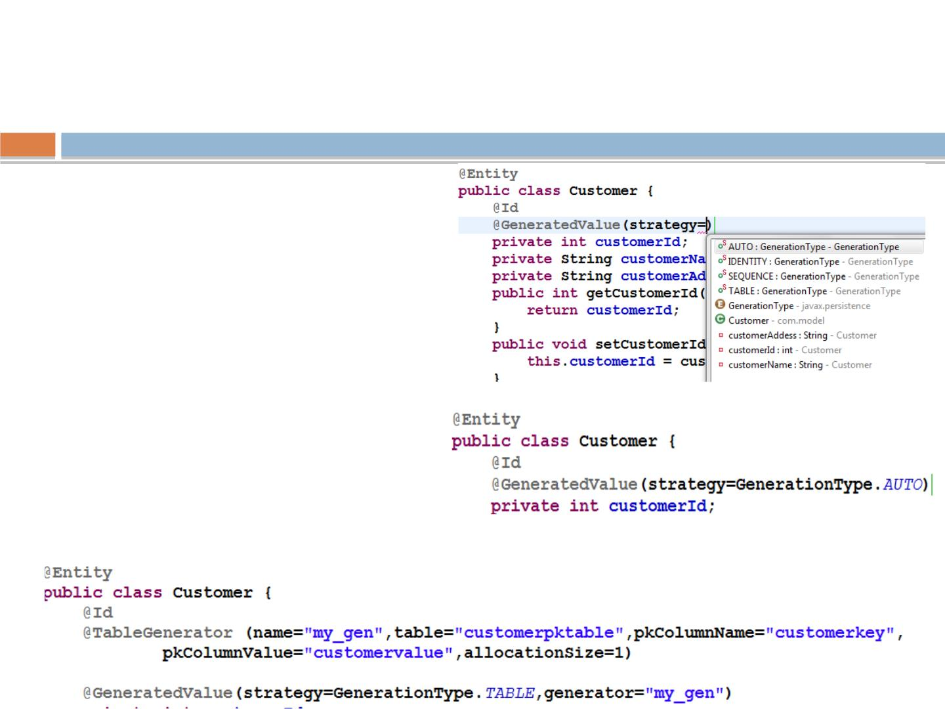
Primary Keys with @Id and
@GeneratedValue
❖
❖
@GeneratedValue annotation is
used to decide primary key
generation strategies
This takes a pair of attributes:
strategy and generator. The
strategy attribute must be a
value from the
javax.persistence.GeneratorTyp
e enumeration. If you do not
specify a generator type, the
default is AUTO

Slide 32
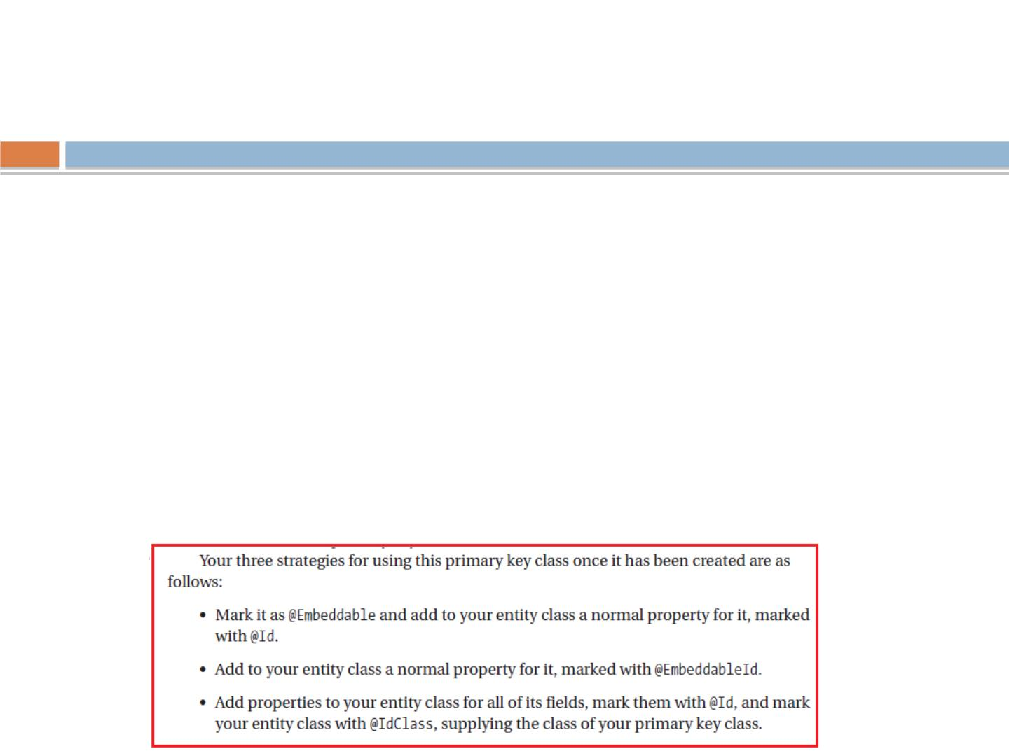
Compound Primary Keys
◻
What if we need some business primary key?
◻
Yo u must create a class to represent the primary ke y.
◻
Condition to be primary key class:
◉
It must be a public class
◉
It must have a default constructor
◉
It must be serializable
◉
It must implement hashCode() and equals() methods to allow the
Hibernate code
◉
Compound Primary Keys with @Id, @IdClass, or @EmbeddedId
◉
Consider that business requirment is that we need to represent
customer primary key as a combination of customerId and

Slide 33
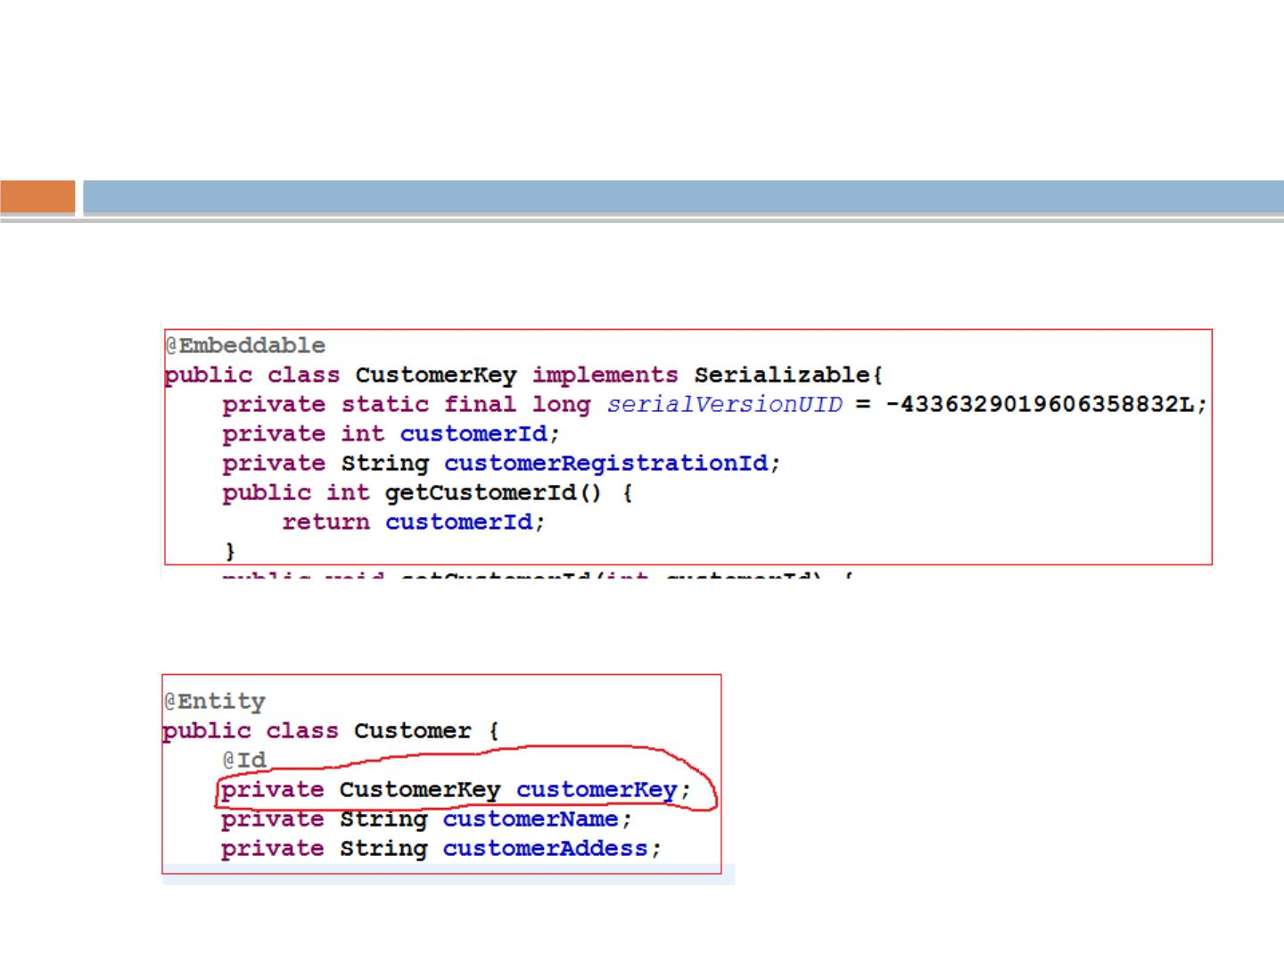
Compound Primary Keys with @Id
1. Create an POJO annotated with @Embeddable ( it must
implements Serilizable interface and must have default
2. Use it in target class
rgupta.mtech@gmail.com Java Training Hibernate

Slide 34
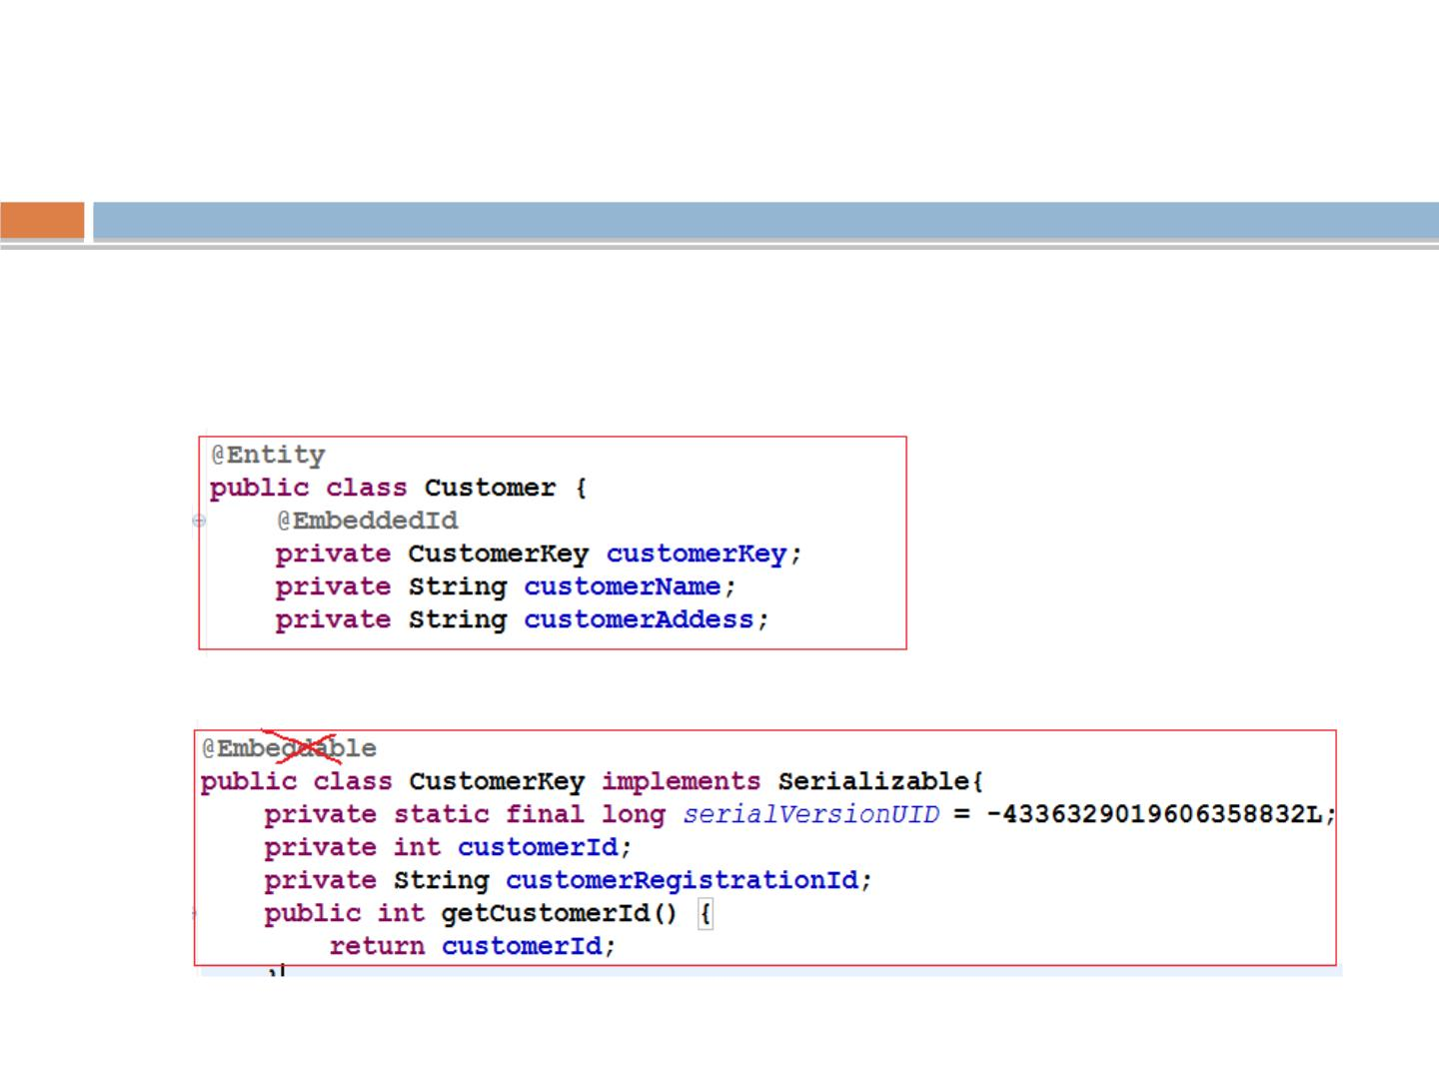
Compound Primary Keys
@EmbeddedId
◻
Here, the primary key class cannot be used in other tables
since it is not an @Embeddable entity, but it does allow us
to treat the key as a single attribute of the Account class
◻
No need to mention @Embeddable on CustomerKey class
rgupta.mtech@gmail.com Java Training Hibernate

Slide 35
Workshop topics
❖
❖
Hibernate-What it is ?
❖ HQL and the Query Object
JPA- What it is?
❖ one class to two tables
❖ Select and Pagination in HQL
❖ Named Quaries
❖
❖
❖
ORM and Issues
Hibernate Hello World CRUD
Primary key generation strategy
More annotations
❖
Criteria API
❖
❖
❖
❖
Hibernate Object life cycle
Hibernate Architecture
Relation mapping
❖ Hibernate caching
❖ First Level
❖ Second Level Cache
❖ Hibernate optimization
❖ Hibernate Batch Processing
❖
Many-to-one mapping
❖
one-to-one mapping
❖
Many-to-Many mapping
❖
Inheritance in Hibernate
❖
Single Table Strategy
❖
Table Per Class Strategy
❖
Joined Strategy
rgupta.mtech@gmail.com Java Training Hibernate

Slide 36
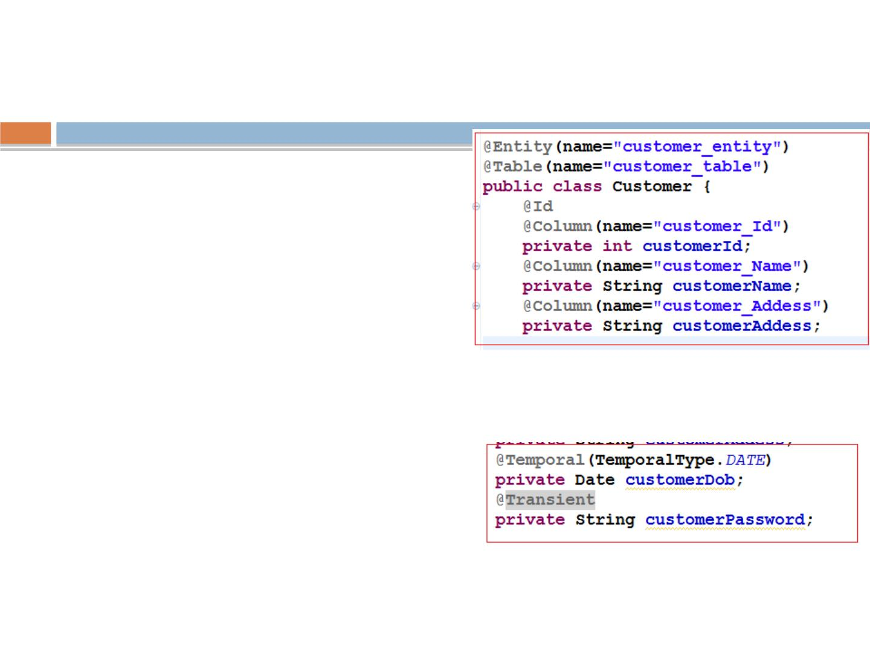
More Annotations
◻
What if table name and ﬁeld name is
something else?
◉
Use annotation @Table,@Column
◉
@Tomporal
◻
@Lob?
◻
@Tomporal?
◉
Storing date and time.
◉
What if i want only to store date part not
time?
What is the diﬀerence bw
■
@Temporal(TemporalType.DATE)
applying name using @Table and
@Entity
◻
◻
@Transient?
◉
You can not store static and transient data.
@Basic ?
◉
Used to add some properties to add to that
ﬁeld.
◉
You can work apply without it.
rgupta.mtech@gmail.com Java Training Hibernate

Slide 37
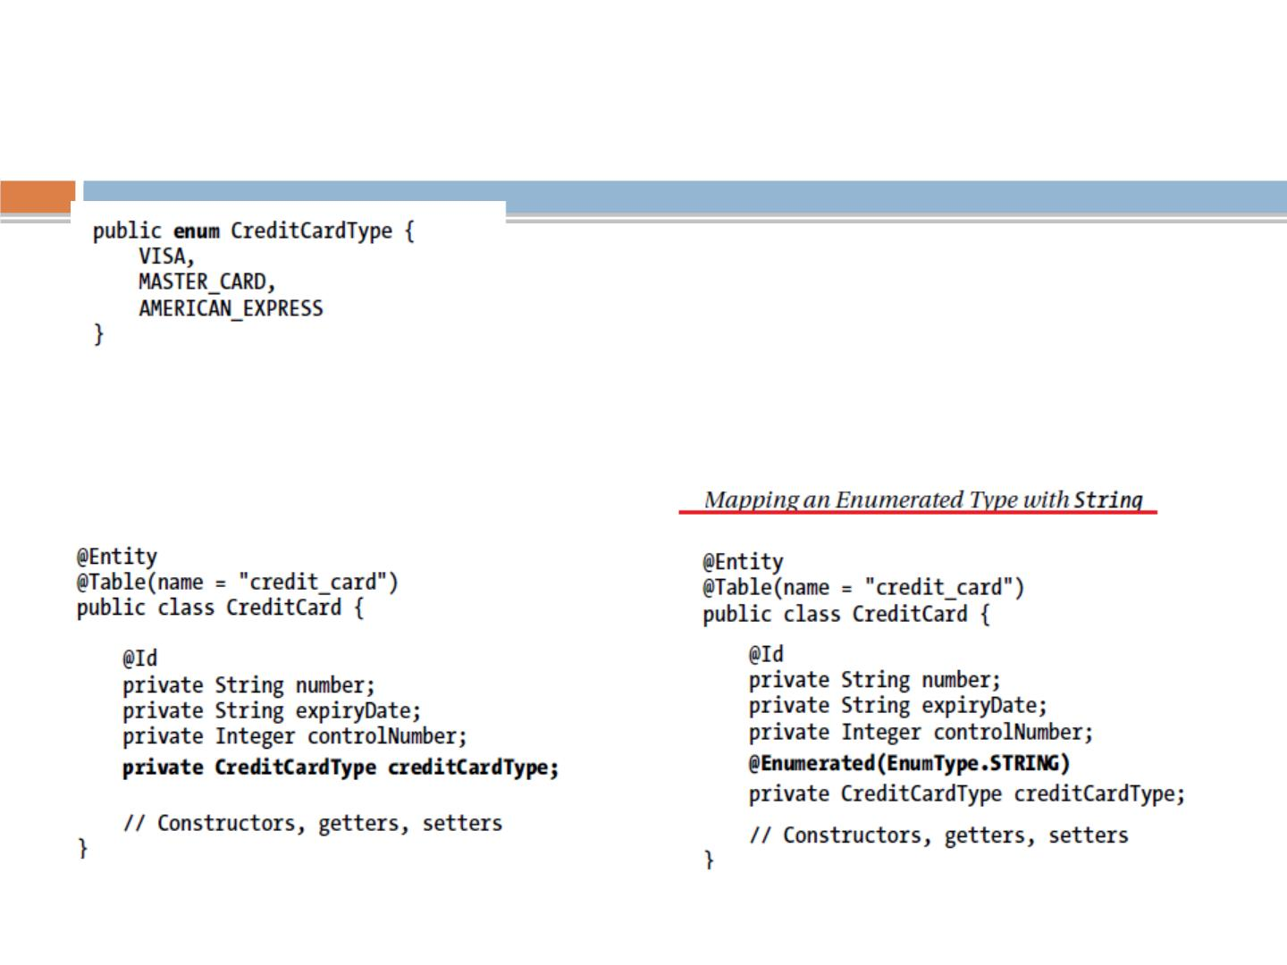
@Enumerated
rgupta.mtech@gmail.com

Slide 38
Workshop topics
❖
❖
Hibernate-What it is ?
❖ HQL and the Query Object
JPA- What it is?
❖ one class to two tables
❖ Select and Pagination in HQL
❖ Named Quaries
❖
❖
❖
❖
ORM and Issues
Hibernate Hello World CRUD
Primary key generation strategy
More annotations
❖
Criteria API
❖
❖
❖
Hibernate Object life cycle
Hibernate Architecture
Relation mapping
❖
Hibernate caching
❖ First Level
❖ Second Level Cache
❖
Many-to-one mapping
❖ Hibernate optimization
❖ Hibernate Batch Processing
❖
one-to-one mapping
❖
Many-to-Many mapping
❖
Inheritance in Hibernate
❖
Single Table Strategy
❖
Table Per Class Strategy
❖
Joined Strategy
rgupta.mtech@gmail.com Java Training Hibernate

Slide 39
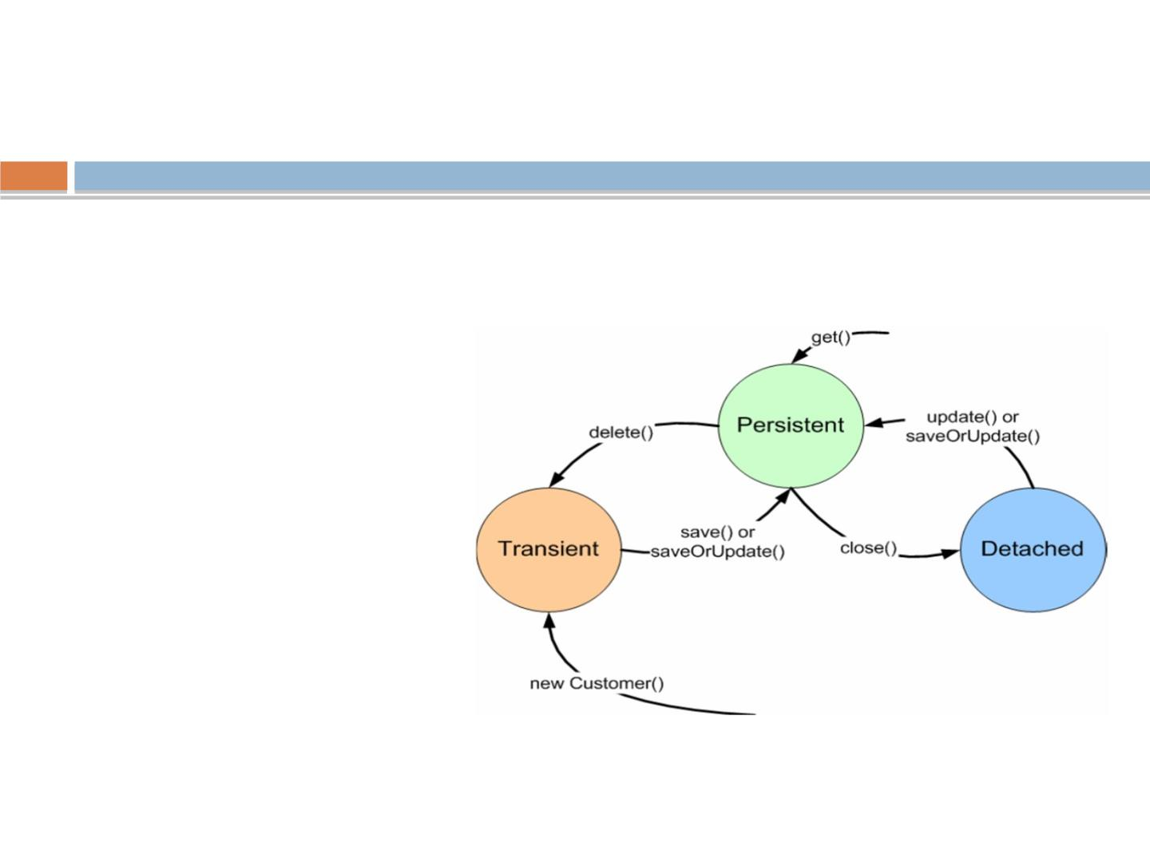
Object lifecycle
◻
Given an instance of an object that is mapped to
Hibernate, it can be in any one of three states:-
■
Transient
■
Persistence
■
Detached
rgupta.mtech@gmail.com Java Training Hibernate

Slide 40
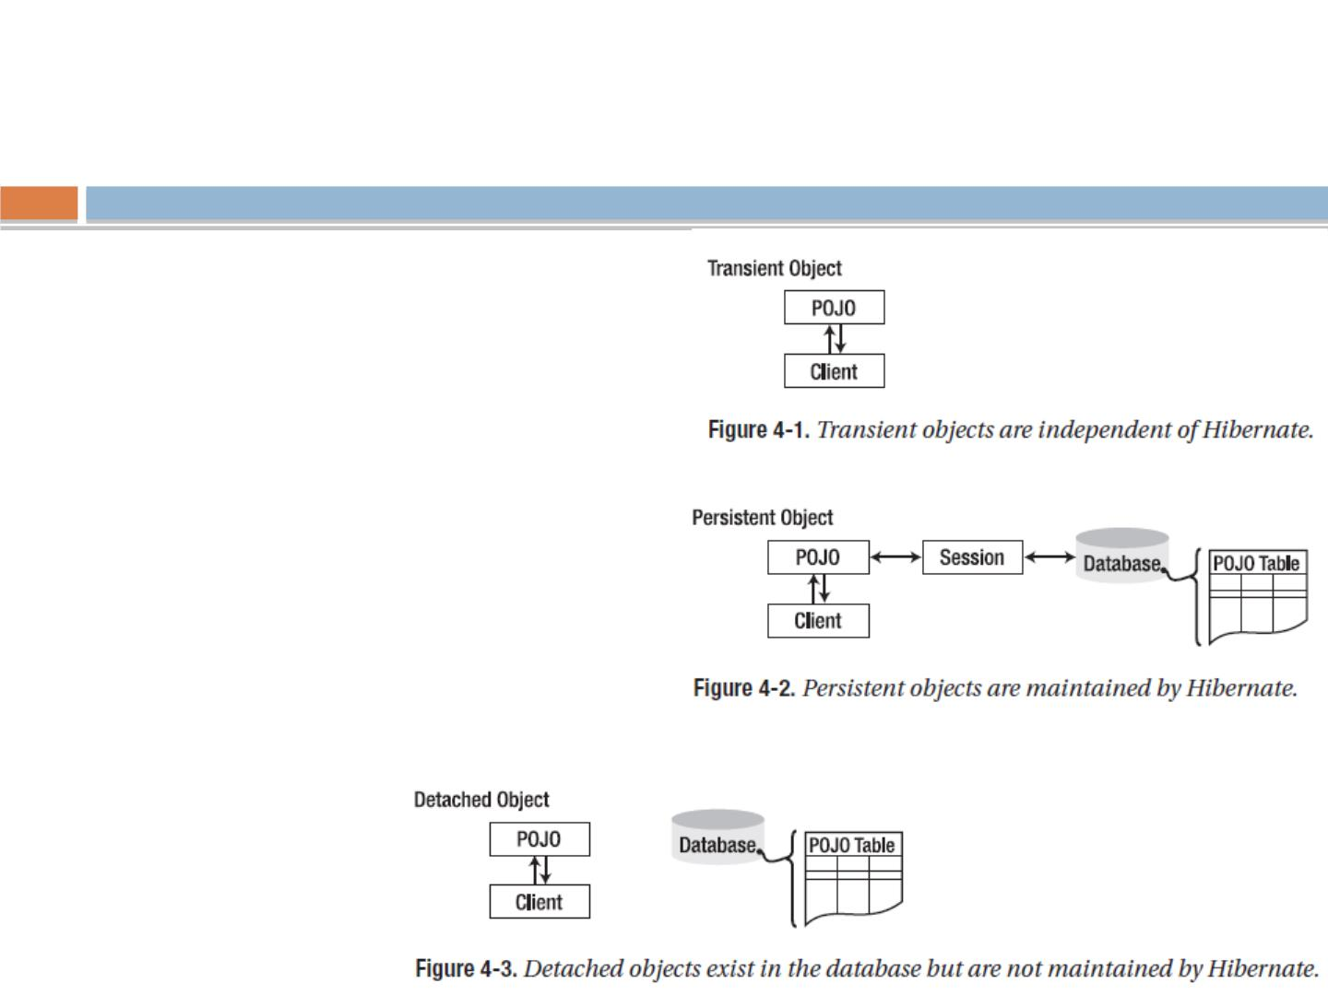
More on Object Life Cycle
◻
Transient objects exist in memory,
Hibernate does not manage transient objects
or persist changes to transient objects.
Hibernate Don’t care about that object
◻
Persistent objects exist in the database,
and Hibernate manages the persistence for
persistent objects. If ﬁelds or properties
change on a persistent object, Hibernate will
keep the database representation up-to-date.
◻
Detached objects have a representation in
the database, but changes to the object will
not be reﬂected in the database, and vice
versa.
◻
A detached object can be created by closing
the session that it was associated with, or by
evicting it from the session with a call to the
session’s evict() method.
rgupta.mtech@

Slide 41
Workshop topics
❖
❖
Hibernate-What it is ?
❖ HQL and the Query Object
JPA- What it is?
❖ one class to two tables
❖ Select and Pagination in HQL
❖ Named Quaries
❖
❖
❖
❖
❖
ORM and Issues
Hibernate Hello World CRUD
Primary key generation strategy
More annotations
❖
Criteria API
Hibernate Object life cycle
Hibernate Architecture
Relation mapping
❖ Hibernate caching
❖ First Level
❖ Second Level Cache
❖ Hibernate optimization
❖ Hibernate Batch Processing
❖
❖
❖
Many-to-one mapping
❖
one-to-one mapping
❖
Many-to-Many mapping
❖
Inheritance in Hibernate
❖
Single Table Strategy
❖
Table Per Class Strategy
❖
Joined Strategy
rgupta.mtech@gmail.com Java Training Hibernate

Slide 42
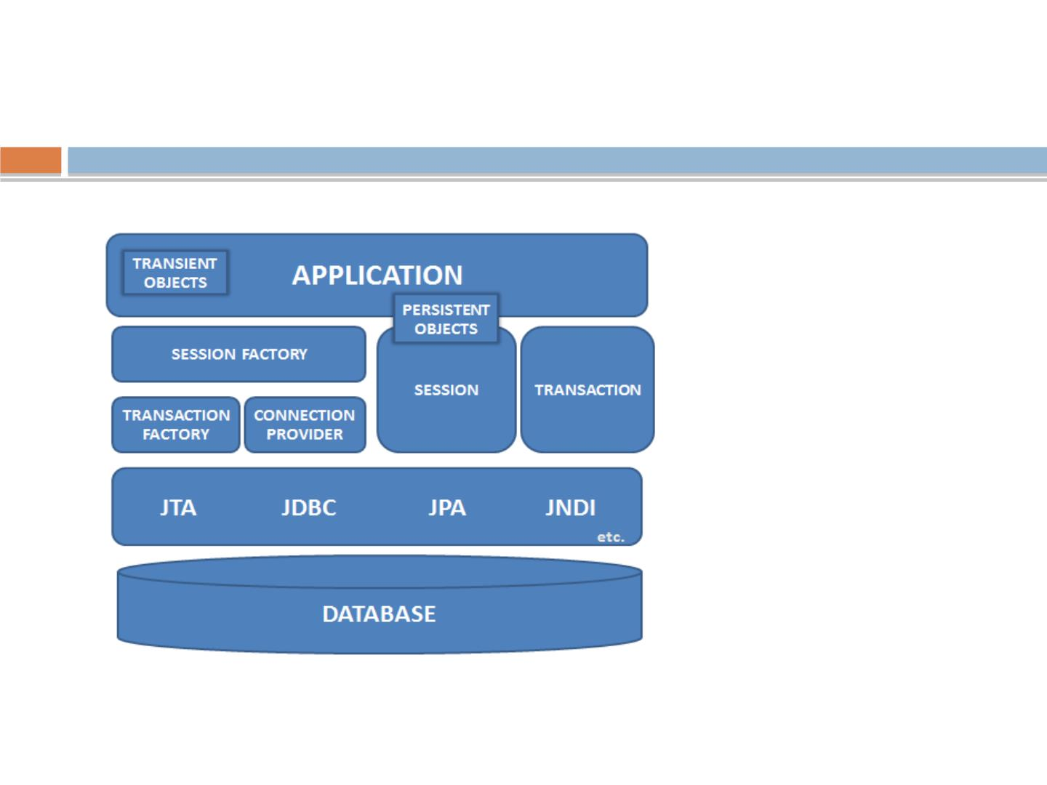
Hibernate Architecture
rgupta.mtech@gmail.com Java Training Hibernate

Slide 43
Core Interfaces
◻
Used to perform basic CRUD and
querying operations
◉
Session
◉
SessionFactory
◉
Conﬁguration
◉
Transaction interface
◉
Query
◉
Criteria
rgupta.mtech@gmail.com Java Training Hibernate

Slide 44
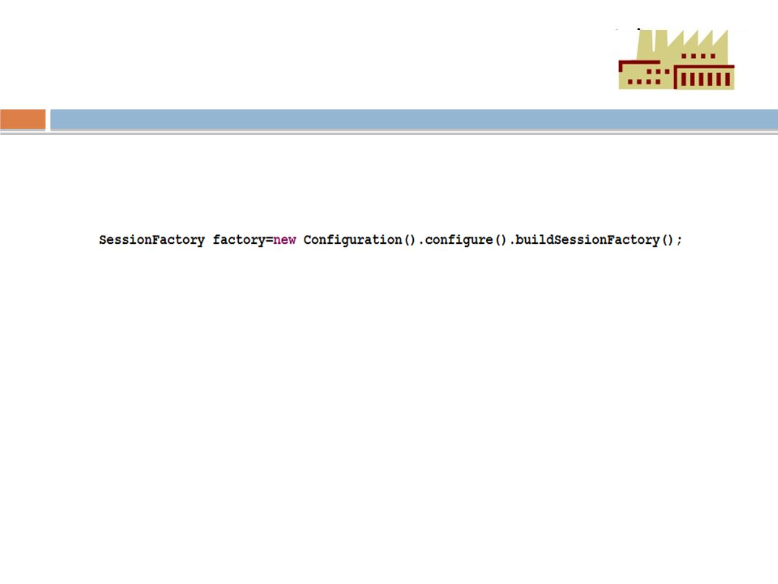
SessionFactory
◻
The application obtains Session instances from a
SessionFactory interface
◻
The SessionFactory is created from an conﬁguration object.
◻
The SessionFactory is an expensive object to create
◻
It too is created at application start-up time
◉
It should be created once and kept for latter use.
◉
The SessionFactory object is used by all the threads of an applications
◉
it is thread safe object
◉
one SessionFactory object is created per database (where connecting
to multiple sessions)
◻
The SessionFactory is used to create Session Objects
rgupta.mtech@gmail.com Java Training Hibernate

Slide 45
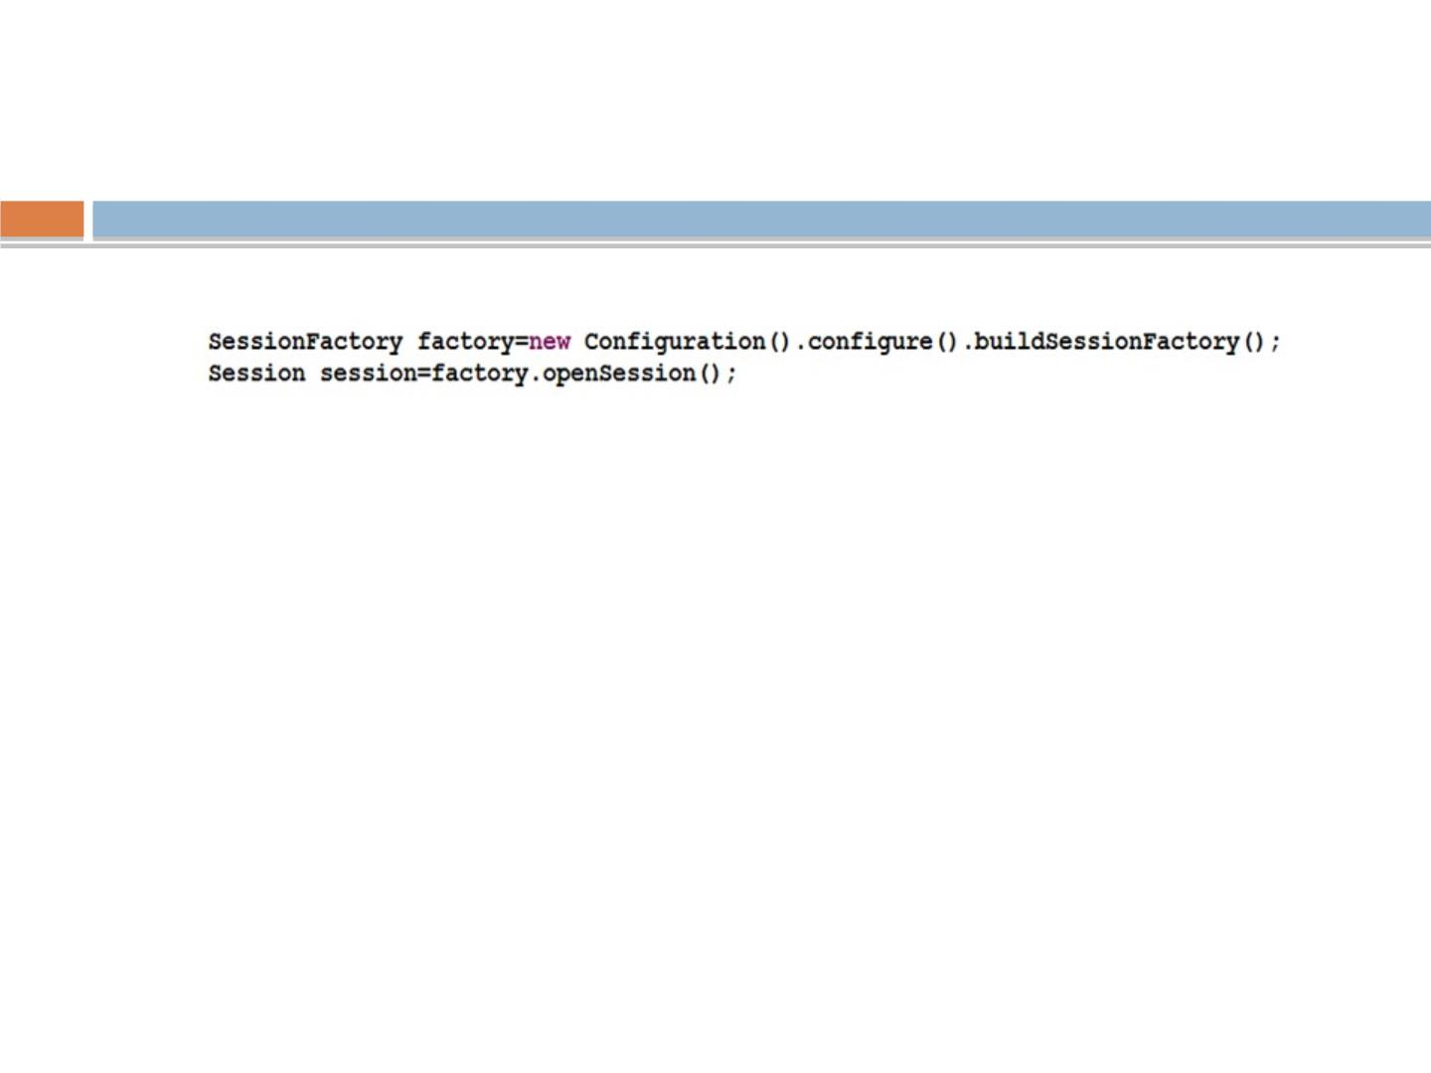
Session
◻
The Session object is created from the SessionFactory object
■
A Session object is lightweight and inexpensive to create.
■
Session object provides the main interface to accomplish work with the
database
■
Does the work of getting a physical connection to the database (hopefully
from a connection pool)
■
Session objects are not thread safe
■
Session objects should not be kept open for a long time
■
Application create and destroy these as needed. Typically they are created
to complete a single unit of work.
◻
When modiﬁcations are made to the database, session objects
are used to create a transaction object
rgupta.mtech@gmail.com Java Training Hibernate

Slide 46
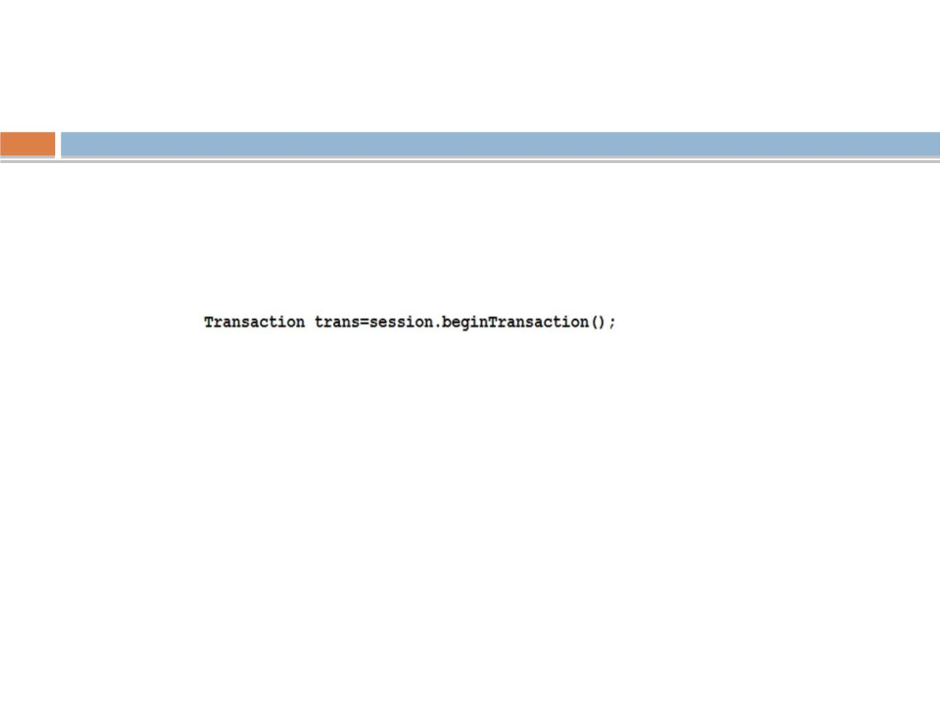
Transaction
◻
Transaction objects are obtained from the
session objects, when an modiﬁcation to the
database is needed.
◻
The Transaction object provides abstraction for
the underlying implementation
■
Hibernate with use whatever transaction implementation
is available (JDBC, J TA etc.)
■
It is optional; allowing developer to use their own
transactional infrastructure.
■
Transaction objects should be kept open for a short time.
rgupta.mtech@gmail.com Java Training Hibernate

Slide 47
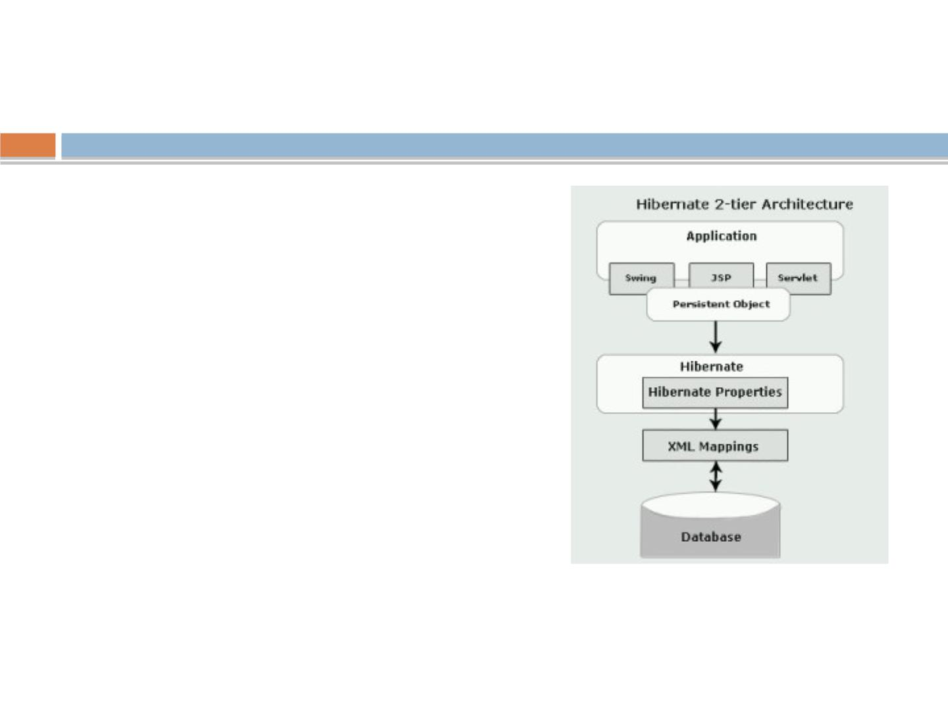
How hibernate actually works with JDBC?
◻
By default Hibernate creates a proxy for
each of the entity class in mapping ﬁle.
This class contain the code to invoke
JDBC.
◻
◻
Proxies are created dynamically by sub-
classing the entity object at runtime.
The subclass has all the methods of the
parent, so when a method on the entity
object is called, the proxy loads up the
data from the database and calls the
method.
rgupta.mtech@gmail.com Java Training Hibernate

Slide 48
Persistent object states
◻
The POJO or persistent objects can be in
one of the three states is deﬁned in
relation to a persistence context (that
means it is loaded into the Hibernate
Session object)
◉
Transient
◉
Persistent
◉
Detached
rgupta.mtech@gmail.com Java Training Hibernate

Slide 49
Transient state
◻
◻
The instance is not associated with any persistence
context. It has no persistent identity or primary key value.
Transient instances may be made persistent by calling
save(), persist() or saveOrUpdate() method on Session
object
rgupta.mtech@gmail.com Java Training Hibernate

Slide 50
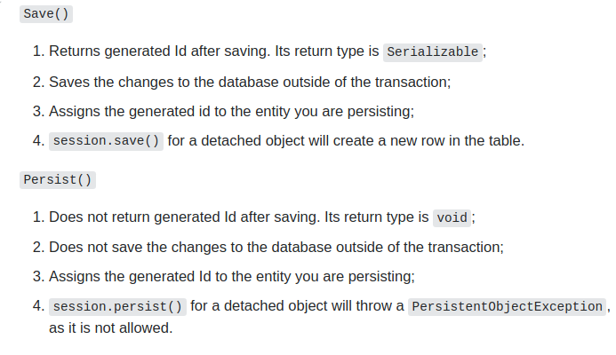
save() vs pesist()
.
.

Slide 51
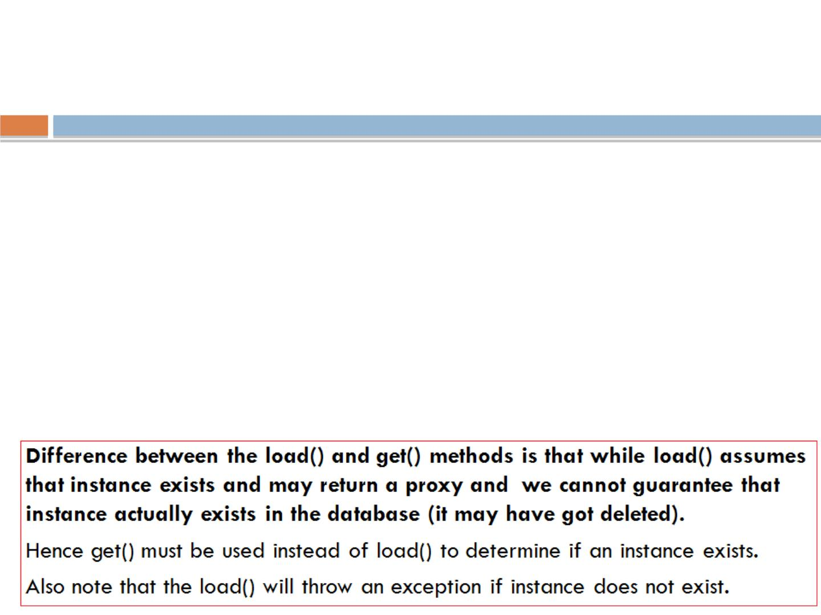
Diﬀerent between get() and load()
◻
both functions are use to retrieve an object with diﬀerent
mechanism
◻
session.load()
◉
It will always return a “proxy” (Hibernate term) without hitting
the database.
◉
proxy object look like a temporary fake object.
◉
If no row found , it will throws an ObjectNotFoundException.
◻
session.get()
◉
It always hit the database and return the real object,an object
that represent the database row, not proxy.

Slide 52
Detached State
◻
The instance was once associated with a persistence
context/session but not is not attached to it may because the
session was closed.
◻
◻
It has a persistent identity and can have a corresponding row in
the database.
While for persistent instance Hibernate guarantees the
relationship between persistent (database ) identity and Java
identity for detached instance there is no such guarantees .
◻
◻
Detached instances may be made persistent by calling
update(), saveOrUpdate()
The state of a transient or detached instance may also be made
persistent as a new persistent instance by calling merge().
rgupta.mtech@gmail.com Java Training Hibernate

Slide 53
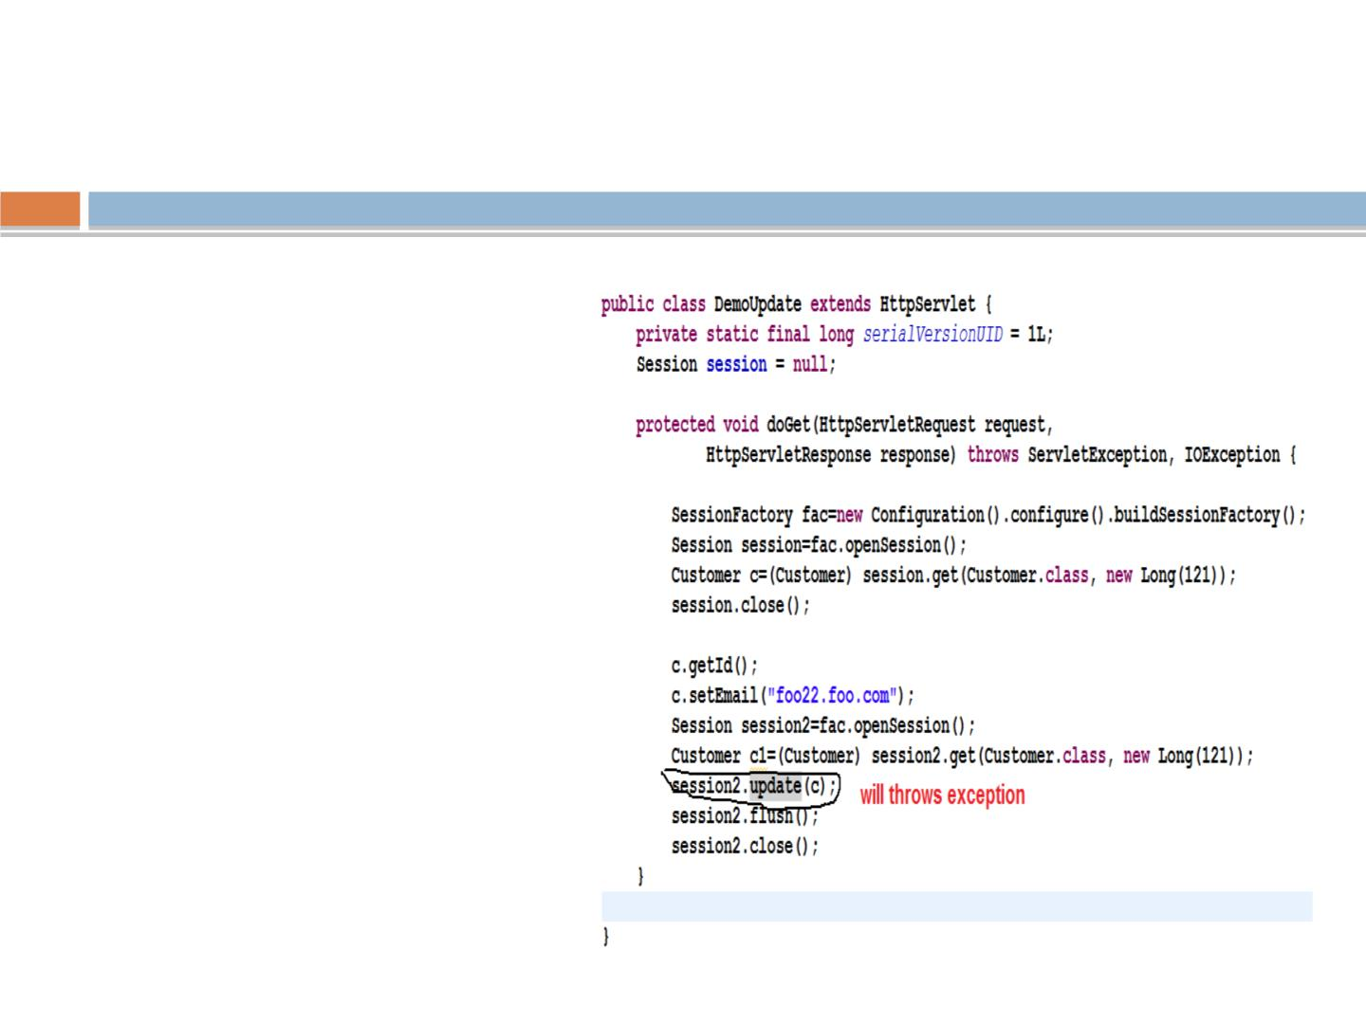
update(),merge() diﬀerences
•Update should be used
to save the data when
the session does not
contain an already
persistent instance with
the same identiﬁer.
•Merge should be used
to save the
modiﬁcations at any
time without knowing
about the state of a
session
•
To understand difference
bw updaterg(u)p taa.mndte cmhe@rggmea(il.)c om Java Training Hibernate
lets try to update values

Slide 54
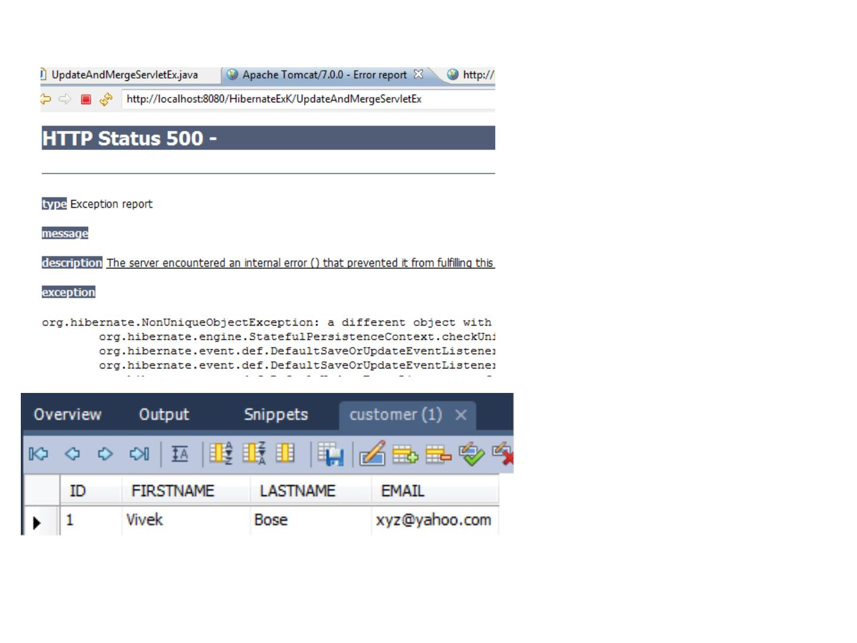
When
session2.update(c);
is used instead of
session2.merge(c);
This is if there is a
persistent instance
with the same
identiﬁer in the
session, update() will
throw an exception!
When
session2.merge(c);
is used the data gets
updated because the
instance that the
session is holding
gets its values from
the detached instance
when merge is called
on detached instance.
rgupta.mtech@gmail.com Java Training Hibernate

Slide 55
delete() and refresh()
◻
void delete(Object object) throws
HibernateException
◉
Remove a persistent instance from the datastore. The argument
may be an instance associated with the receiving Session or a
transient instance with an identiﬁer associated with existing
persistent state. This operation cascades to associated instances if
the association is mapped with cascade="delete".
◻
void refresh(Objectꢀobject) throws
HibernateException
This method is useful to sync the state of the given instance with
underlying database in cases where there are chances that database
might have been altered outside the application as a result of a trigger.
This is also useful in cases where direct SQL is used by the application
rgupta.mtech@gmail.com Java Training Hibernate
to update the data.

Slide 56
ﬂush(), close(), clear()
◻
void flush() throws HibernateException
◉
This is the method that actually synchronizing the underlying database with
persistent object held in session memory.
◉
This should be called at the end of a unit of work, before committing the
transaction and closing the session (depending on flush-mode,
Transaction.commit() calls this method).
◻
◻
Connection close() throws HibernateException
◉
End the session by releasing the JDBC connection and cleaning up. It is not
strictly necessary to close the session but at least it must be disconnected
by calling disconnect()
void clear()
◉
Completely clear the session. Evict all loaded instances and cancel all
pending saves, updates and deletions. Do not close open iterators or
instances of ScrollableResults.
rgupta.mtech@gmail.com Java Training Hibernate

Slide 57
Transaction
◻
Transaction can be set using the methods of Session.
Transaction beginTransaction() throws HibernateException
If Transaction object is associated with the session return that else create a new
transaction.
Transaction getTransaction()
Get the Transaction instance associated with this session
In both the cases the class of the returned Transaction object is determined by
the property hibernate.transaction_factory.
◻
◻
The most common approach is the session-per-
request pattern where a single Hibernate Session
has same scope as a single database transaction.
The Hibernate session can be used for multiple DB
operations (save, query, update) within the same request.
rgupta.mtech@gmail.com Java Training Hibernate

Slide 58
Transaction methods
◻
◻
◻
◻
◻
◻
void begin() throws HibernateException
void commit() throws HibernateException
void rollback() throws HibernateException
To check if transactions was committed or rolled-back properly
boolean wasRolledBack() throws HibernateException
boolean wasCommitted() throws HibernateException
◻
Code snippet wrapping statements in a
transactions:
Session sess = factory.openSession();
Transaction tx;
try
{
tx = sess.beginTransaction();
//do some work ...
tx.commit();
}
catch (Exception e)
{
rgupta.mtech@gmail.com Java Training Hibernate
if (tx!=null) tx.rollback(); throw e; }
finally { sess.close(); }

Slide 59
Workshop topics
❖
❖
Hibernate-What it is ?
❖ HQL and the Query Object
JPA- What it is?
❖ one class to two tables
❖ Select and Pagination in HQL
❖ Named Quaries
❖
❖
❖
❖
❖
❖
ORM and Issues
Hibernate Hello World CRUD
Primary key generation strategy
More annotations
❖
Criteria API
Hibernate Object life cycle
Hibernate Architecture
Component Mapping
Relation mapping
❖ Hibernate caching
❖ First Level
❖ Second Level Cache
❖ Hibernate optimization
❖ Hibernate Batch Processing
❖
❖
❖
Many-to-one mapping
❖
one-to-one mapping
❖
Many-to-Many mapping
❖
Inheritance in Hibernate
❖
Single Table Strategy
❖
Table Per Class Strategy
rgupta.mtech@gmail.com Java Training Hibernate
❖
Joined Strategy

Slide 60
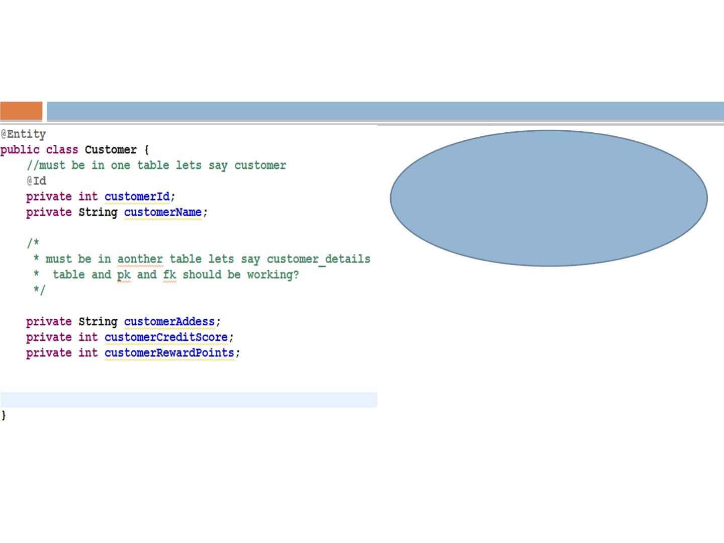
One class to two tables
Let we want to store the
object of customer in two
diﬀerent tables?
We have to decide what should
be the tables names?
Lets say Customer and other
other table CustomerDetails
We have to decide what ﬁelds
should go in each tables?

Slide 61
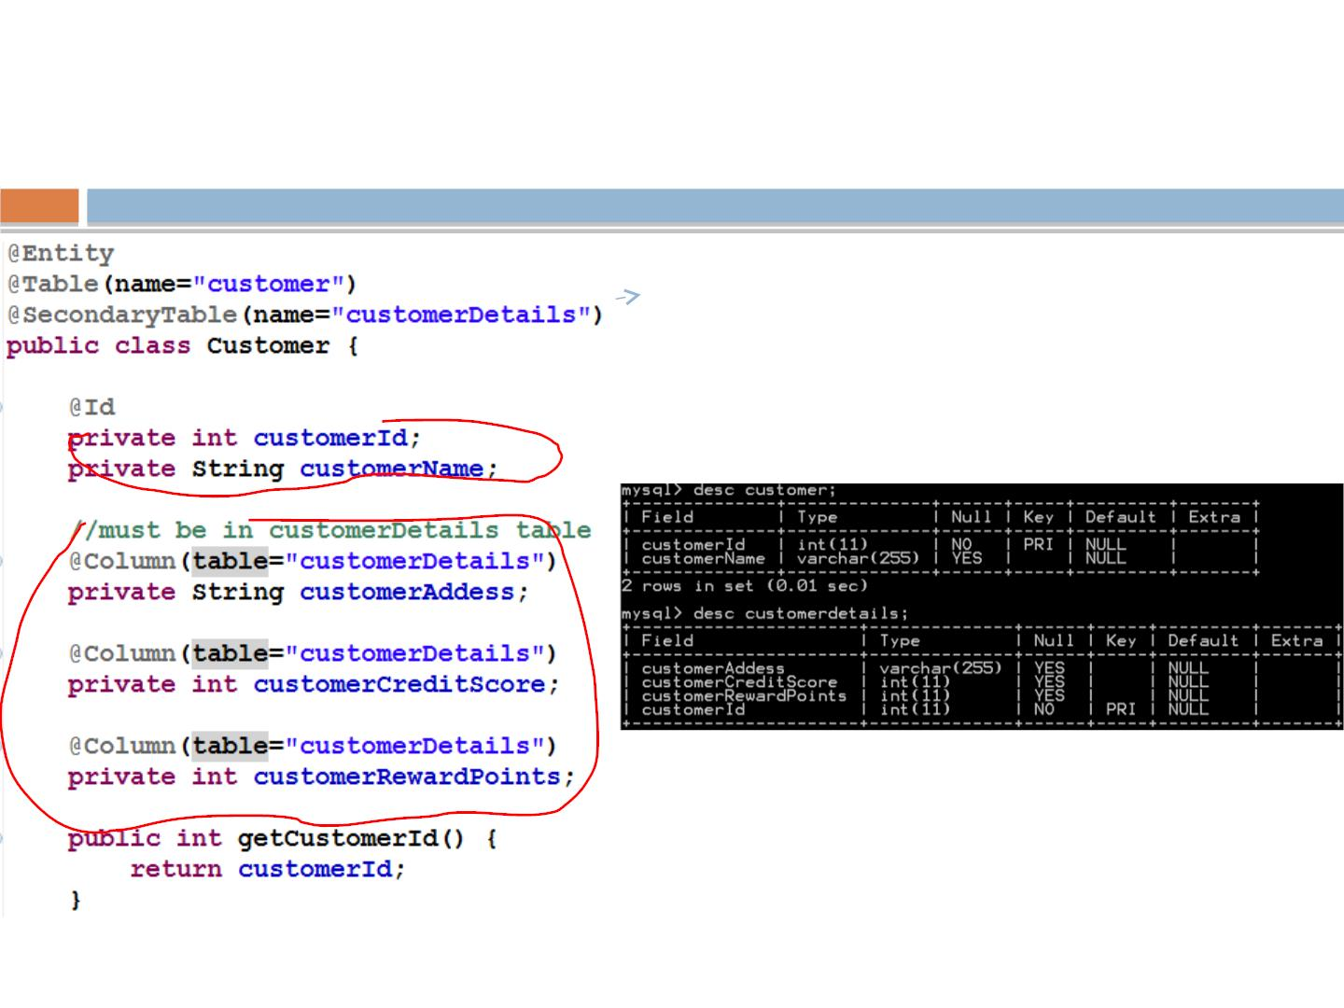
One class to two tables:
solutions
SecondaryTable
annotation is the
key!!!
rgupta.mtech@gmail.com Java Training Hibernate

Slide 62
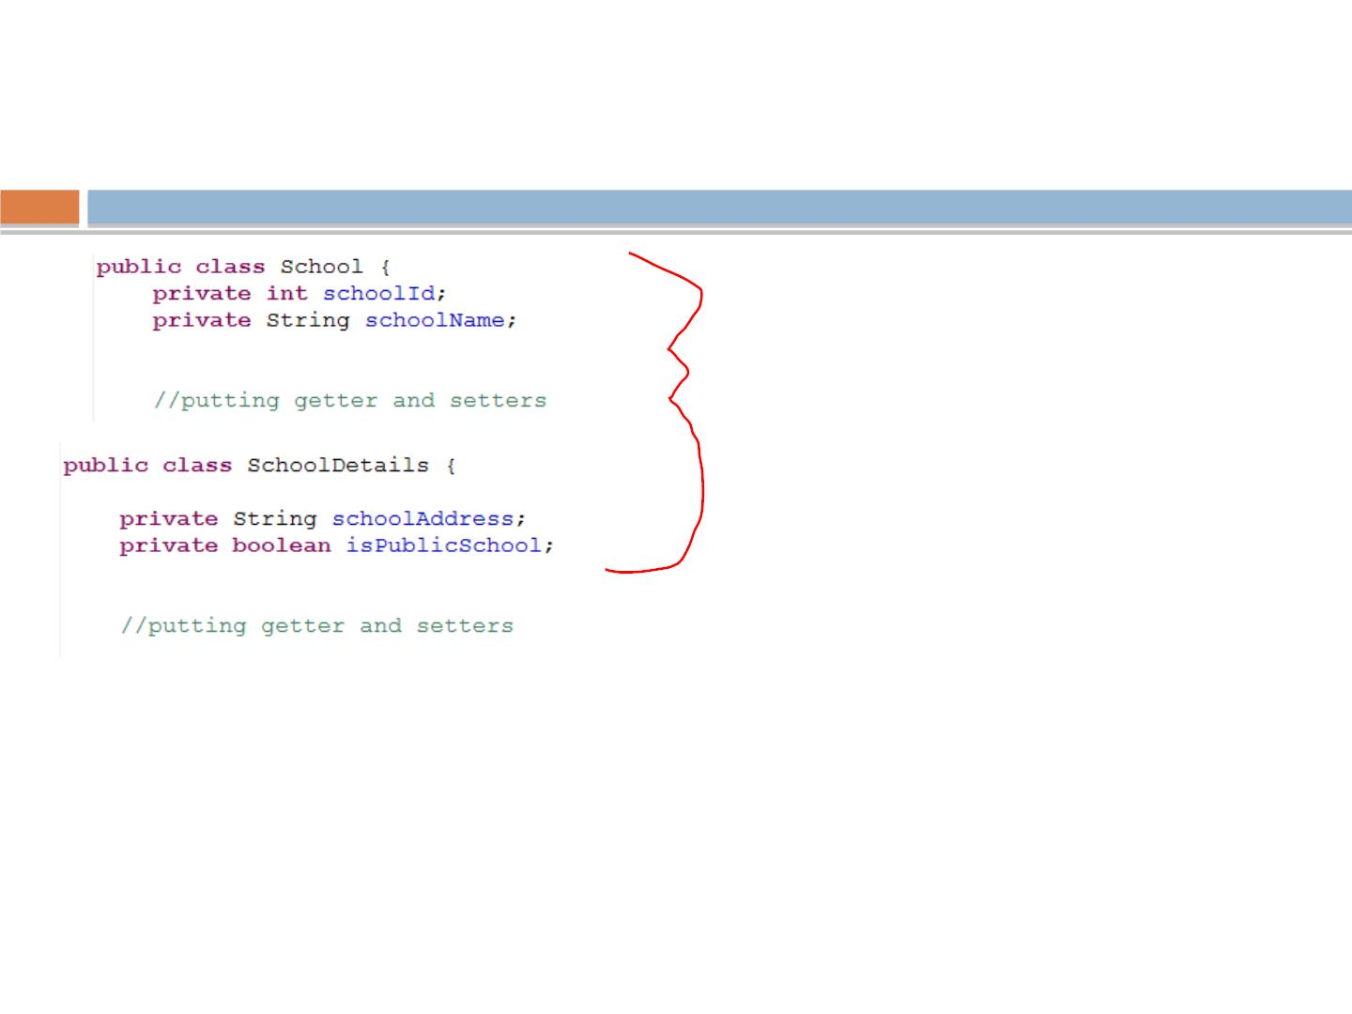
One table from two classes
Want to have one table
for two classes…..
What to do?
rgupta.mtech@gmail.com Java Training Hibernate

Slide 63
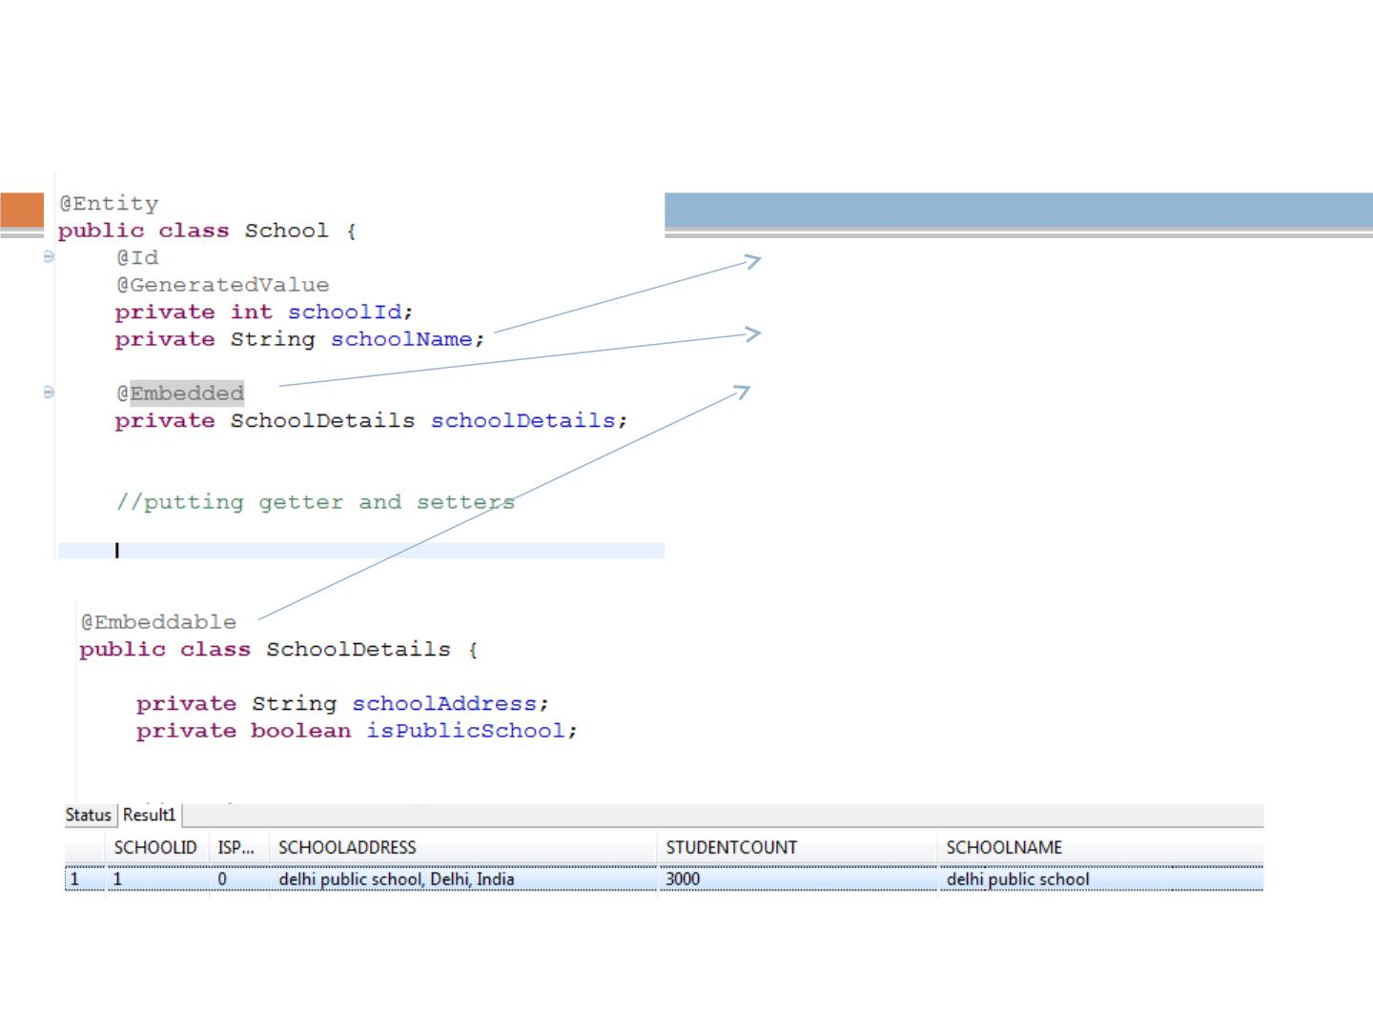
One table from two classes: Solutions
◻
1. put ref of SchoolDetails in
School class (embedded class)
◻
2. declare SchoolDetails as
embedded class
◻
3. Declare SchoolDetails as
@Embeddable (dont declare it
@Entity)
rgupta.mtech@gmail.com Java Training Hibernate

Slide 64
Workshop topics
❖
❖
Hibernate-What it is ?
❖ HQL and the Query Object
JPA- What it is?
❖ one class to two tables
❖ Select and Pagination in HQL
❖ Named Quaries
❖
❖
❖
❖
❖
❖
❖
ORM and Issues
Hibernate Hello World CRUD
Primary key generation strategy
More annotations
❖
Criteria API
Hibernate Object life cycle
Hibernate Architecture
Component Mapping
Relation mapping
❖ Hibernate caching
❖ First Level
❖ Second Level Cache
❖ Hibernate optimization
❖ Hibernate Batch Processing
❖
❖
Many-to-one mapping
❖
one-to-one mapping
❖
Many-to-Many mapping
❖
Inheritance in Hibernate
❖
Single Table Strategy
❖
Table Per Class Strategy
rgupta.mtech@gmail.com Java Training Hibernate
❖
Joined Strategy

Slide 65
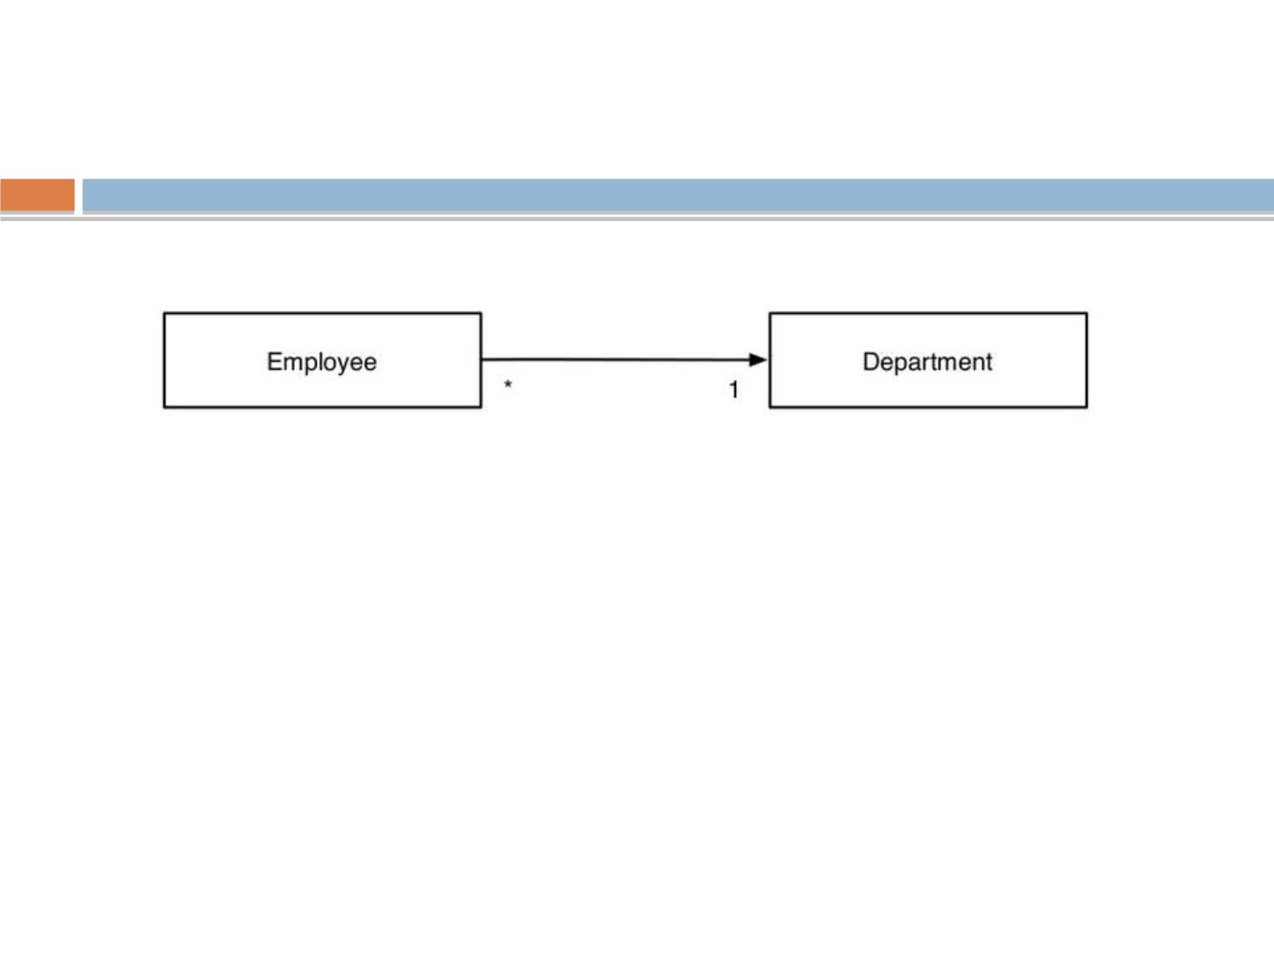
Relationship Mapping
◻
Most of time we required to map relationship between entities
Every relationship has four characteristics:
◻
Directionality: Unidirectional vs Bidirectional ?
◻
Role: Each entity in the relationship is said to play a role. Depending
on directionality, we can identity the entity playing the role of sources
and entity playing the role of target
◻
Cardinality: The number of entity instances that exists on each side of
the relationship
◻
Ownership: One of the two entities in the relationship is said to own
the relationship. Employee is called owner of relationship and
Department is called reverse-owner of relationship
rgupta.mtech@gmail.com Java Training Hibernate

Slide 66
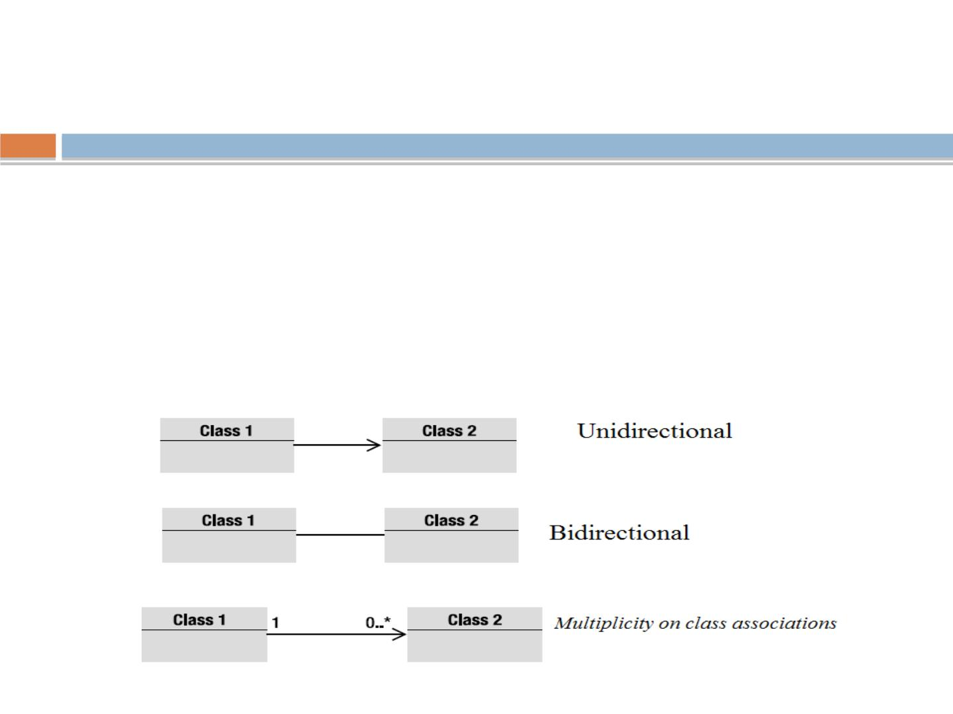
Relationship Mapping
◻
OO relations
◉
Association between the Objects
■
IS-A, HAS-A, USE-A
◻
An association has a direction:
◉
Unidirectional
◉
rgupta.mtech@gmail.com

Slide 67
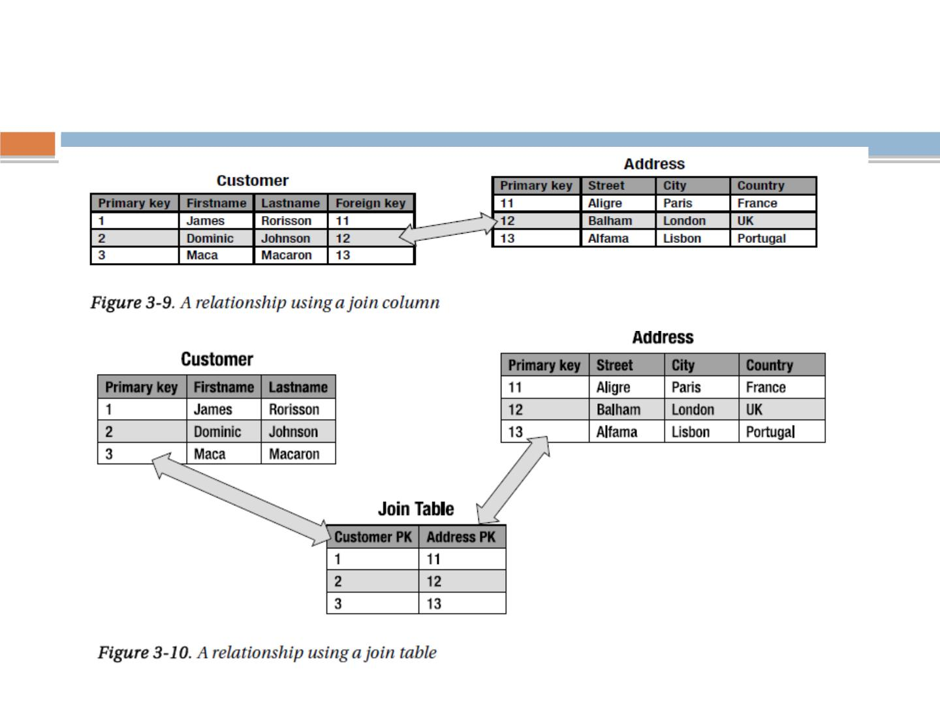
Relationships in Relational Databases
rgupta.mtech@gmail.com

Slide 68
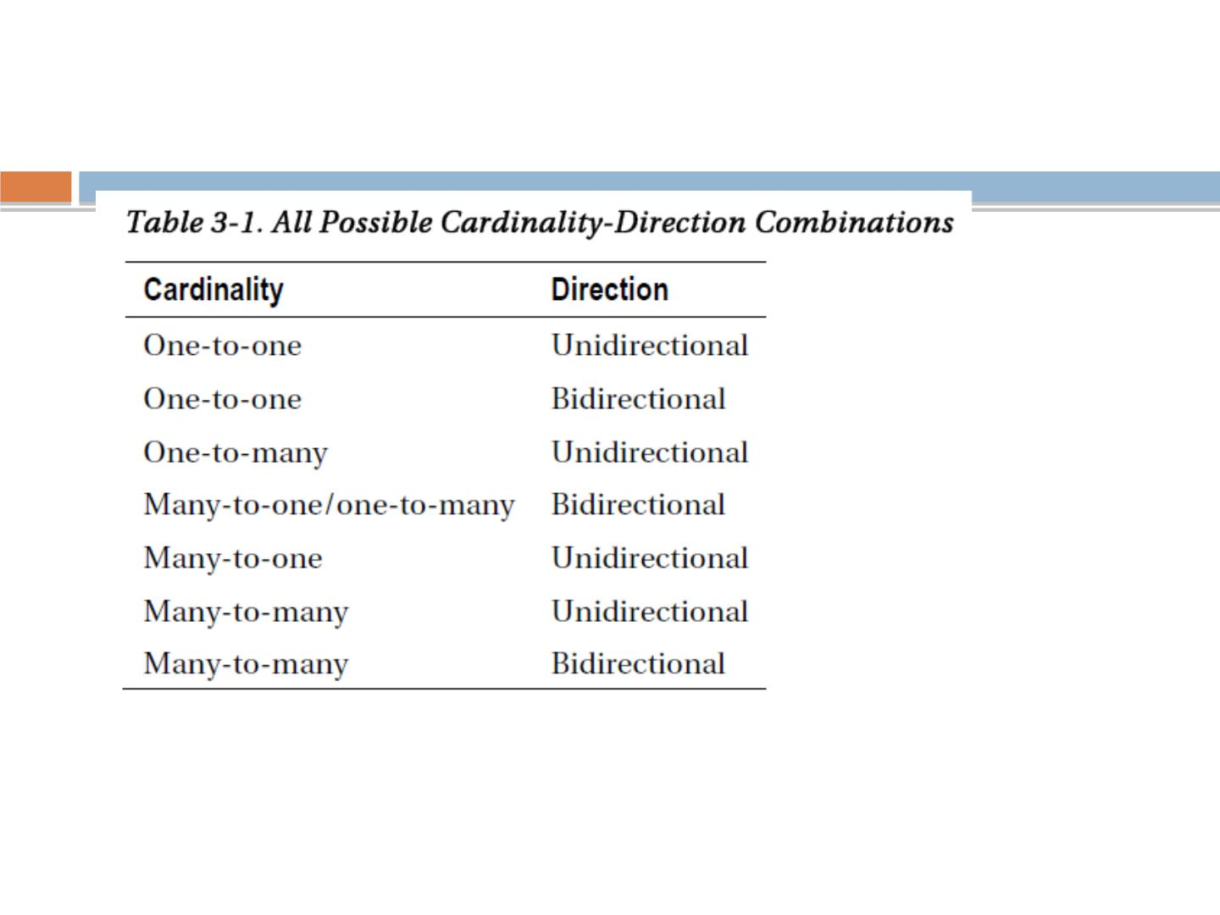
Entity Relationships
rgupta.mtech@gmail.com

Slide 69
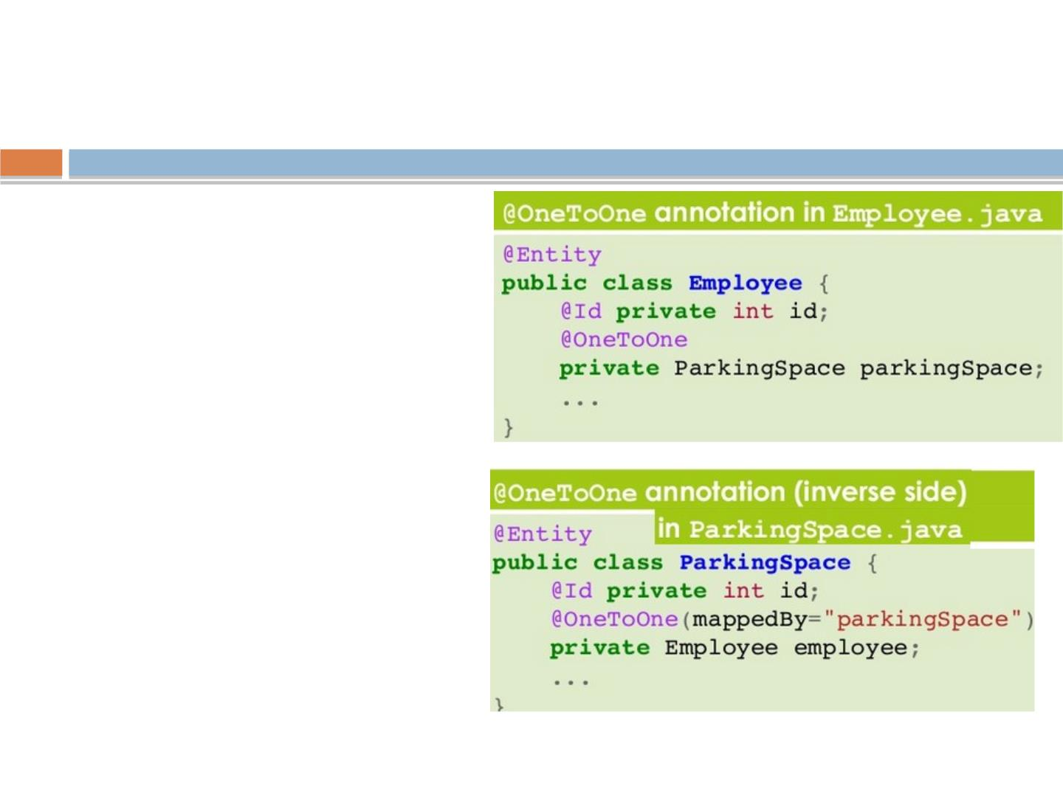
one-to-one mapping
◻
In a one-to-one mapping the
owner can be either the
source entity or the target
entity.
◻
one-to-one mapping is
deﬁned by annotating the
owner entity with the
@OneToOne annotations
◻
If the one-to-one mapping is
bidirectional the inverse
side of the relationship need
to be speciﬁed too
◻
ꢀIn the non owner entity, the
@OneToOne annotations
must come with the
mappedBy element

Slide 70
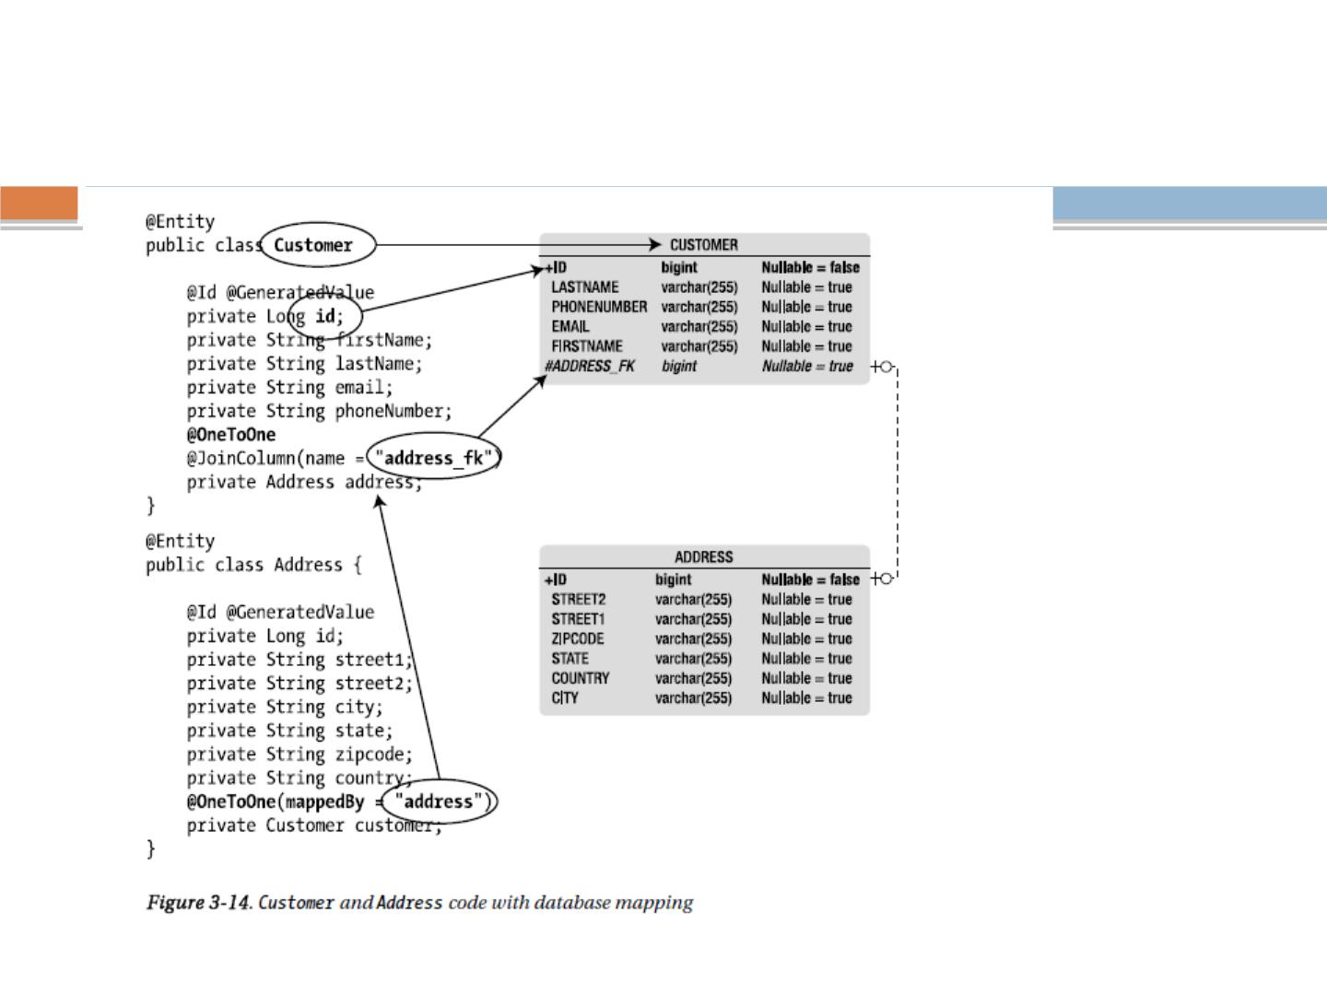
One to one Bidirectional
rgupta.mtech@gmail.com

Slide 71
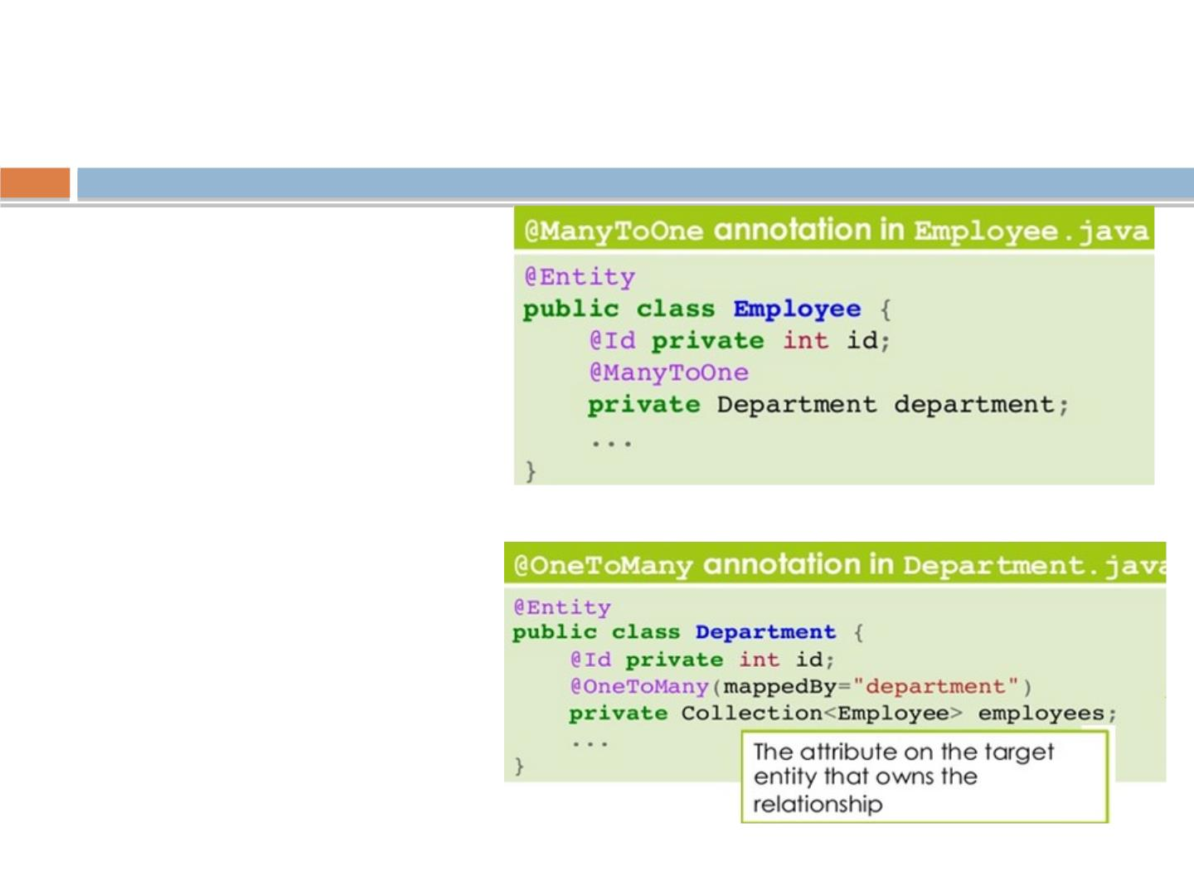
One to many mapping
◻
In an Many-to-one
mapping the
owner of the
relationship is the
source entity.
◻
ꢀA Many-to-one
mapping is
deﬁned by
annotating the
source entity with
@ManyToOne
annotation

Slide 72
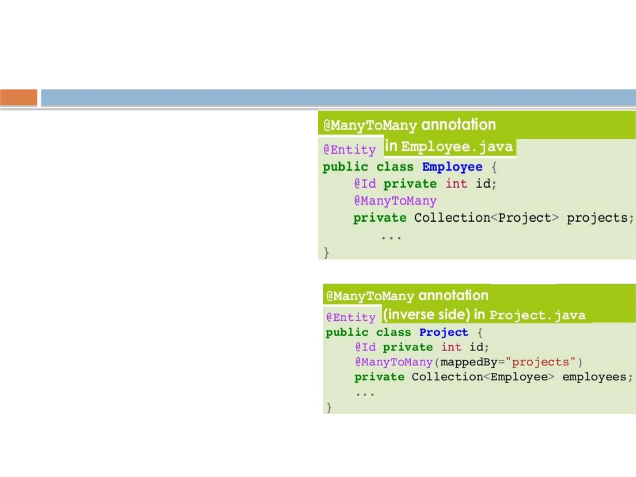
Many-to-Many mapping
◻
In a Many-to-Many mapping
there is no join column . The
only way to implement such a
mapping is by means of a join
table
◻
◻
◻
ꢀTherefore, we can arbitrarily
specify as owner either the
source entity or the target
entity
If the many-to-many mapping is
bi-directional, the inverse side
of the relationship need to be
speciﬁed too.
ꢀIn the non owner entity the
@ManyToMany annotation must
come with mappedBy elements

Slide 73
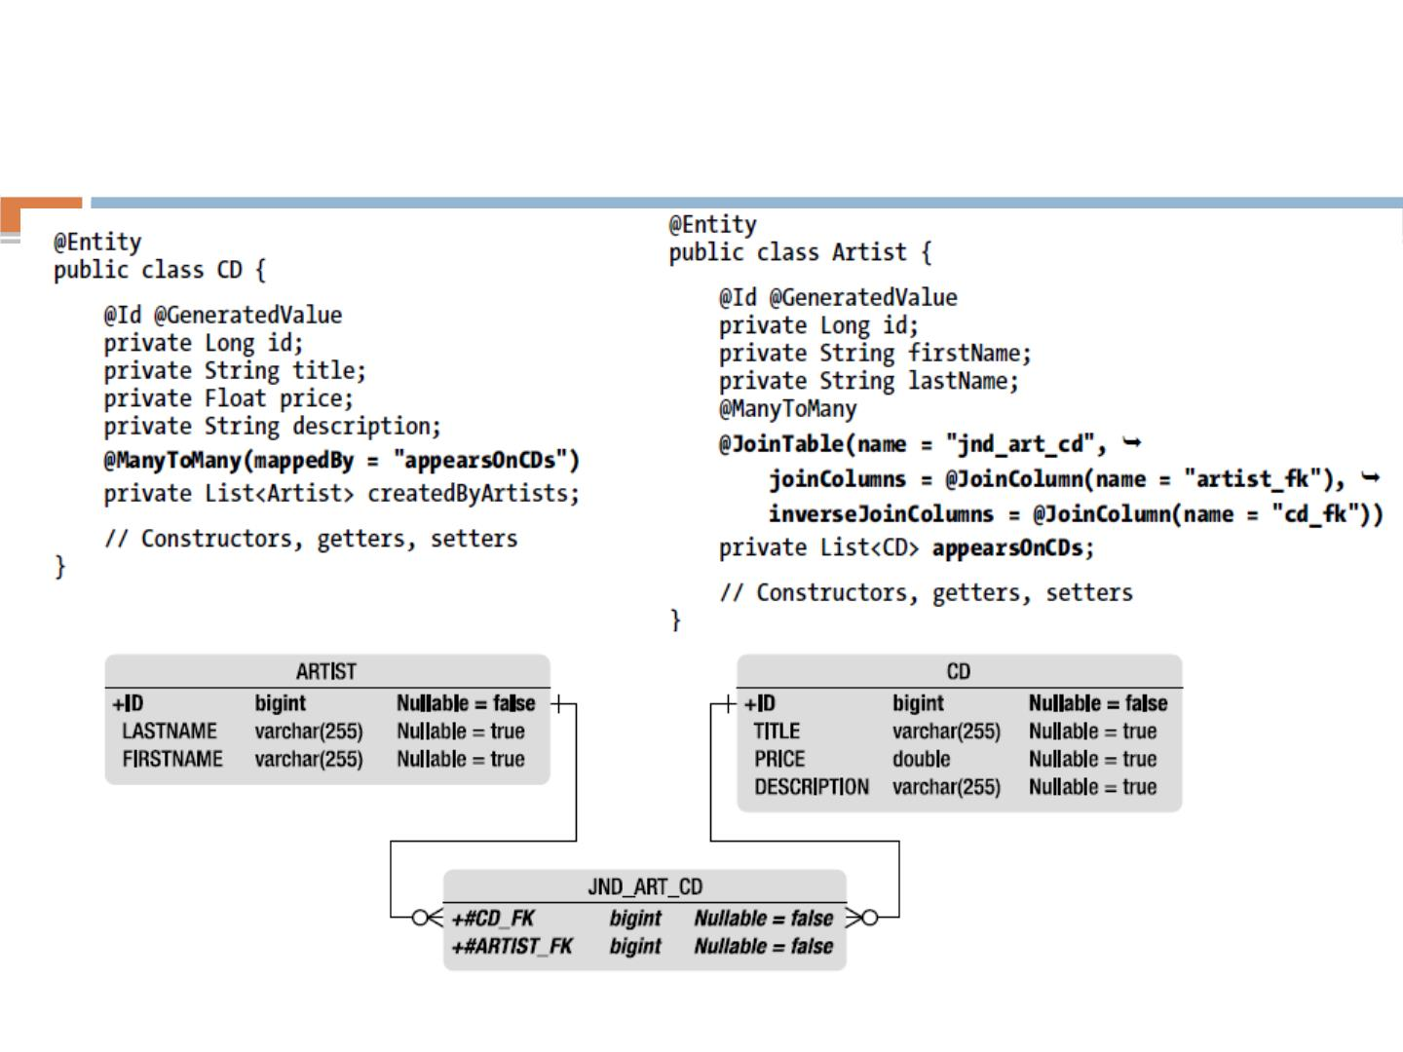
Many to Many Bi-
directional
rgupta.mtech@gmail.com

Slide 74

@OrderBy
◻
Dynamic ordering can be done with the @OrderBy annotation.
“Dynamically” means that the ordering of the elements of a
collection is made when the association is retrieved
rgupta.mtech@gmail.com

Slide 75

Lazy Loading
◻
The performance can be optimized by deferring the fetching of such data
until they are actually needed.ꢀThis design pattern is called lazy loading
◻
At relationship level, lazy loading can be of great help in enhancing
performance because it can reduce the amount of SQL get executed.
◻
the fetch mode can be speciﬁed on any of the four relationship mapping
types
◻
ꢀThe parkingSpace attributers may not be loaded each time employee is

Slide 76
When the fetch mode is not speciﬁed
◻
On a single valued relationship the related object is guaranteed
to be loaded eagerly and Collection-valued relationship default to
be lazily loaded
◻
ꢀIn case of bi-directional relationship the mode might be lazy on
one side but eager on the other
◻
Quite common situation, relationship are often accessed in
diﬀerent way depending on the direction from which navigation
occurs.
◉
ꢀThe directive to lazily fetch an attribute is meant only to be hint to the
persistence provider
◉
The provider is not required to respect the request as the behaviour of
the entity will not be compromised if the provider decides to eagerly
load data.
◉
ꢀThe converse is not true because specifying that an attributes be
eagerly fetched might be critical to access the entity once detached.

Slide 77

Cascading operations
◻
Hibernate/JPA provides a mechanism to deﬁne when operations such as
save()/persist() should be automatically cascaded across relationships
◻
Yo u need to be sure that Address instance bas been set on Employee
instance before invoking persist() on it.
◻
ꢀThe cascade attribute accepts several possible values coming from the
cascade Type enumerations
◉
PERSIST, REFRESH, REMOVE, MERGE and DETACH
◻
The constant ALL is a shorthand for declaring that all ﬁve operations
should be cascaded.
◻
ꢀAs for relationship, cascade settings are unidirectional
◻
They must be explicitly set on both sides of a relationship if the same
behaviours is inte

Slide 78
Collection of Basic Types
◻
@ElementCollection annotation is used to indicate that an
attribute of type java.util.Collection contains a collection of
instances of basic types (i.e., nonentities)
◻
Attribute can be of the following types:
◉ • java.util.Collection: Generic root interface in the collection
hierarchy.
◉ • java.util.Set: Collection that prevents the insertion of
duplicate elements.
◉ • java.util.List: Collection used when the elements need to be
retrieved in some
◉ user-deﬁned order.
rgupta.mtech@gmail.com

Slide 79

Collection of Basic Types
Book Entity with
collection of
Strings
rgupta.mtech@gmail.com

Slide 80

Embeddables
rgupta.mtech@gmail.com

Slide 81
Workshop topics
❖
❖
Hibernate-What it is ?
❖ HQL and the Query Object
JPA- What it is?
❖ one class to two tables
❖ Select and Pagination in HQL
❖
❖
❖
❖
❖
❖
❖
❖
ORM and Issues
Hibernate Hello World CRUD
Primary key generation strategy
More annotations
❖
Named Quaries
❖ Criteria API
Hibernate Object life cycle
Hibernate Architecture
Component Mapping
❖ Hibernate caching
❖ First Level
❖
Second Level Cache
Relation mapping
❖ Hibernate optimization
❖
Many-to-one mapping
❖ Hibernate Batch Processing
❖
one-to-one mapping
❖
Many-to-Many mapping
❖
Inheritance in Hibernate
❖
Single Table Strategy
❖
Table Per Class Strategy
rgupta.mtech@gmail.com Java Training Hibernate
❖
Joined Strategy

Slide 82

Mapping Inheritance
◻
Inheritance can be used also
for persistent objects, for
factoring out data members
inherited by multiple
subclasses
◻
The mapping of a hierarchy to
the database can follow
diﬀerent strategies: -
–Single table per hierarchy
–Table per class(table per concrete class
–Joined

Slide 83
Inheritance
◻ Single table (single table per hierarchy)
◉
Here only one table is going to be created, all ﬁelds mapped to single table.
◉
Not very memory eﬃcient, Faster, support polymorphic quaries
◻Joined (as per normalization)
◉
Separate table mapped to all classes in the hierarchy
◉
Three table is created Account, SavingAccount, CurrentAccount, as per normalization, table are need to join to get all data (sql outer join)
◻Table per class(◻Table per concrete class)
◉
Two table is going to create SavingAccount and CurrentAccount
Sql Union operation is required to get data, Identity auto gen key is not supported
◉
A U B, Not Supported by all vendors

Slide 84

Single table (single table per hierarchy)
rgupta.mtech@gmail.com Java Training Hibernate

Slide 85

Table per class
rgupta.mtech@gmail.com Java Training Hibernate

Slide 86
Workshop topics
❖
❖
Hibernate-What it is ?
❖ HQL and the Query Object
JPA- What it is?
❖ Select and Pagination in HQL
❖ Named Quarries
❖
❖
❖
❖
❖
❖
❖
❖
ORM and Issues
Hibernate Hello World CRUD
Primary key generation strategy
More annotations
❖
Criteria API
❖
❖
Hibernate caching
❖ First Level
❖ Second Level Cache
Hibernate optimization
Hibernate Object life cycle
Hibernate Architecture
Component Mapping
Relation mapping
❖ Hibernate Batch Processing
❖
Many-to-one mapping
❖
one-to-one mapping
❖
Many-to-Many mapping
❖
Inheritance in Hibernate
❖
Single Table Strategy
❖
Table Per Class Strategy
❖
rgupta.mtech@gmail.com Java Training Hibernate
Joined Strategy

Slide 87
HQL
◻
◻
HQL is OO version of SQL
HQL uses class name instead of table name, and property names
instead of column name
◻
HQL fully supports polymorphic queries
◻
Way to pulling data from the database in the
Hibernate.
1. Using session methods(get() and load() methods)
■
limited control to accessing data
2. Using HQL & Native HQL
■
Slightly more control using where clause
3. Using Criteria API
■
The criteria API is an alternative of HQL queries.
■
It is more powerful and ﬂexible for writing tricky criteria
functions and dynamic queries
rgupta.mtech@gmail.com Java Training Hibernate

Slide 88
HQL Syntax
◻
HQL Queries elements:
◉
Clauses, Aggregate functions, Subqueries
◻
Clauses in the HQL are:
◉
from, select, where, order by, group by
◻
Aggregate functions are:
◉
avg(...), sum(...), min(...), max(...) , count(*)
◉
count(...), count(distinct ...), count(all...)
rgupta.mtech@gmail.com Java Training Hibernate

Slide 89

Hello World HQL
rgupta.mtech@gmail.com Java Training Hibernate

Slide 90

HQL Insert Query Example
◻
In HQL, only the INSERT INTO … SELECT … is supported;
there is no INSERT INTO … VALUES.
◻
HQL only support insert from another table. For example
rgupta.mtech@gmail.com Java Training Hibernate

Slide 91

Native SQL queries
◻
In Hibernate, HQL or criteria queries should be able to let you to execute
almost any SQL query you want.
◻
However, many developers are complaint about the Hibernates generated
SQL statement is slow and more prefer to generated their own SQL (native
SQL) statement
◻
Hibernate provide a createSQLQuery method to let you call your native
SQL statement directly.
◉
In this example, you tell Hibernate to return you a Stock.class, all the
select data (*) will match to your Stock.class properties automatically.
rgupta.mtech@gmail.com Java Training Hibernate

Slide 92

Named Quarries
◻
Give unique name to the Queries that work for entire
application.
◻
The application can use the query by using the name of the
rgupta.mtech@gmail.com Java Training Hibernate

Slide 93

Criteria API in Hibernate
◻
The criteria API is an alternative of HQL queries.
◻
It is more powerful and ﬂexible for writing tricky criteria
functions and dynamic queries
◻
http://stackoverﬂow.com/questions/197474/hibernate-criteria-vs-hql
rgupta.mtech@gmail.com Java Training Hibernate

Slide 94

Criteria API in Hibernate

Slide 95

Criteria API in Hibernate
rgupta.mtech@gmail.com Java Training Hibernate

Slide 96
Workshop topics
❖
❖
Hibernate-What it is ?
❖ HQL and the Query Object
JPA- What it is?
❖ Select and Pagination in HQL
❖ Named Quarries
❖
❖
❖
❖
❖
❖
❖
❖
ORM and Issues
Hibernate Hello World CRUD
Primary key generation strategy
More annotations
❖
Criteria API
❖
❖
Hibernate caching
❖ First Level
❖ Second Level Cache
Hibernate optimization
Hibernate Object life cycle
Hibernate Architecture
Component Mapping
Relation mapping
❖ Hibernate Batch Processing
❖
Many-to-one mapping
❖
one-to-one mapping
❖
Many-to-Many mapping
❖
Inheritance in Hibernate
❖
Single Table Strategy
❖
Table Per Class Strategy
❖
rgupta.mtech@gmail.com Java Training Hibernate
Joined Strategy

Slide 97

Hibernate caching
◻
Caching is a facility provided by ORM frameworks which help users to get
fast running web application, while help framework itself to reduce number
of queries made to database in a single transaction.
◻
Fist level cache in hibernate is enabled by default and you do not need
to do anything to get this functionality working. In fact, you can not disable
it even forcefully.
◻
First level cache is provided by Session Object. First level cache associated
with session object is available only till session object is live. It is available
to session object only and is not accessible to any other session
tion.
ining Hibernate

Slide 98
Important facts about primary
caching
◻
First level cache is associated with “session” object and other
session objects in application can not see it.
◻
The scope of cache objects is of session. Once session is closed,
cached objects are gone forever.
◻
First level cache is enabled by default and you can not disable it.
◻
When we query an entity ﬁrst time, it is retrieved from database
and stored in ﬁrst level cache associated with hibernate session.
◻
If we query same object again with same session object, it will be
loaded from cache and no sql query will be executed.
◻
The loaded entity can be removed from session using evict()
method. The next loading of this entity will again make a database
call if it has been removed using evict() method.
◻
The whole session cache can be removed using clear() method. It
will remove all the entities stored in cache.
rgupta.mtech@gmail.com Java Training Hibernate

Slide 99

Primary caching
◻
Primary caching is by default and you can not disable it.
◻
What if you try to load same object in one session , hibernate don’t
hit database twice, in fact it will hit database ﬁrst time and put
result in cache so that if next time it is request it can be provided
from cache.
◻
As you can see that second “session.load()” statement does
not execute select query again and load the Customer
entity directly.
rgupta.mtech@gmail.com Java Training Hibernate

Slide 100

First level cache case II
◻
First level cache retrieval example with new session
◻
With new session, entity is fetched from database again
irrespective of it is already present in any other session in
rgupta.mtech@gmail.com Java Training Hibernate

Slide 101

Removing cache objects
◻
How to remove from ﬁrst level
cache?
◻
Though we can not disable the ﬁrst level cache in hibernate, but
we can certainly remove some of objects from it when needed.
This is done using two methods :
1
2
rgupta.mtech@gmail.com Java Training Hibernate

Slide 102

Hibernate second level
◻
second level cache is created in
session factory scope and is
available to be used in all sessions
which are created using that particular
session factory.
◻
It means that once session factory
is closed, all cache associated with
it die and cache manager also closed
down.
◻
Further, It also means that if you have
two instances of session factory
(normally no application does that),
you will have two cache managers in
your application and while accessing
cache stored in physical store, you
might get unpredictable results like
cache-miss.
rgupta.mtech@gmail.com Java Training Hibernate

Slide 103
How second level cache works
1. Whenever hibernate session try to load an entity, the very ﬁrst place it look for cached
copy of entity in ﬁrst level cache (associated with particular hibernate session).
2. If cached copy of entity is present in ﬁrst level cache, it is returned as result of load
method.
3. If there is no cached entity in ﬁrst level cache, then second level cache is looked up for
cached entity.
4. If second level cache has cached entity, it is returned as result of load method. But,
before returning the entity, it is stored in ﬁrst level cache also so that next invocation to
load method for entity will return the entity from ﬁrst level cache itself, and there will
not be need to go to second level cache again.
5. If entity is not found in ﬁrst level cache and second level cache also, then database
query is executed and entity is stored in both cache levels, before returning as response
of load() method.
6. Second level cache validate itself for modiﬁed entities, if modiﬁcation has been done
through hibernate session APIs.
7. If some user or process make changes directly in database, the there is no way that
second level cache update itself until “timeToLiveSeconds” duration has passed for that
cache region. In this case, it is good idea to invalidate whole cache and let hibernate
build its cache once again. You can use below code snippet to invalidate whole
hibernate second level cache.
rgupta.mtech@gmail.com Java Training Hibernate

Slide 104
Workshop topics
❖
❖
Hibernate-What it is ?
❖ HQL and the Query Object
JPA- What it is?
❖ Select and Pagination in HQL
❖ Named Quarries
❖
❖
❖
❖
❖
❖
❖
❖
ORM and Issues
Hibernate Hello World CRUD
Primary key generation strategy
More annotations
❖
Criteria API
❖
❖
Hibernate caching
❖ First Level
❖ Second Level Cache
Hibernate optimization
Hibernate Object life cycle
Hibernate Architecture
Component Mapping
Relation mapping
❖ Hibernate Batch Processing
❖
Many-to-one mapping
❖
one-to-one mapping
❖
Many-to-Many mapping
❖
Inheritance in Hibernate
❖
Single Table Strategy
❖
Table Per Class Strategy
❖
rgupta.mtech@gmail.com Java Training Hibernate
Joined Strategy

Slide 105
Workshop topics
❖
❖
Hibernate-What it is ?
❖ HQL and the Query Object
JPA- What it is?
❖ Select and Pagination in HQL
❖ Named Quarries
❖
❖
❖
❖
❖
❖
❖
❖
ORM and Issues
Hibernate Hello World CRUD
Primary key generation strategy
More annotations
❖
Criteria API
❖
❖
Hibernate caching
❖ First Level
❖ Second Level Cache
Hibernate optimization
Hibernate Object life cycle
Hibernate Architecture
Component Mapping
Relation mapping
❖ Hibernate Batch Processing
❖
Many-to-one mapping
❖
one-to-one mapping
❖
Many-to-Many mapping
❖
Inheritance in Hibernate
❖
Single Table Strategy
❖
Table Per Class Strategy
❖
rgupta.mtech@gmail.com Java Training Hibernate
Joined Strategy

Slide 106
JPA

Slide 107
JPA?
◻
What is JPA?
◉ JSR 220, JSR-317 ,Java Persistence 2.0
◉ Speciﬁcation implemented by : Hibernate , eclipseLink, topLink etc
◉ JPA abstraction above JDBC
◉ javax.persistence package
◻
Component of JPA?
◉ ORM
◉ Entity manager API CRUD operations
JPQL
◉
◉ Transactions and locking mechanisms when accessing data concurrently
provided by:
■ Java Transaction API (JTA)
■ Resource-local (non-JTA)
◉ Callbacks and listeners to hook business logic into the life cycle of a persistent
rgupta.mtech@gmail.com

Slide 108


JPA vs Hibernate
rgupta.mtech@gmail.com

Slide 109

EntityManager interacts with Entity
rgupta.mtech@gmail.com

Slide 110

EntityManager Methods
rgupta.mtech@gmail.com

Slide 111

EntityManager Methods
rgupta.mtech@gmail.com

Slide 112

EntityManager Methods remove()
rgupta.mtech@gmail.com

Slide 113

EntityManager Methods persist(), ﬂush(),
refresh()
Forcing
persistenc
e to ﬂush
the data,
to synch
with DB
The refresh() method is used for data synchronization in the opposite direction
of the ﬂush, meaning it
overwrites the current state of a managed entity with data as it is present in the database.
A typical case
is where the EntityManager.refresh() method is used to undo changes that have
been done to the entity
in memory only. The test class snippet in Listing 4-14 ﬁnds a Customer by ID, changes
its ﬁrst name, and
rgupta.mtech@gmail.com
undoes this change using the refresh() method.

Slide 114

EntityManager Methods :Clear and Detach
◻
The clear() method is straightforward: it empties the
persistence context, causing all managed entities to
become detached.
◻
The detach(Object entity) method removes the given entity
from the persistence context.
hronized to the
rgupta.mtech@gmail.com

Slide 115

Merging an Entity
◻
◻
A detached entity is no longer associated with a persistence context. If you want to
manage it, you need to merge it.
Let’s take the example of an entity that needs to be displayed in a JSF page. The
entity is ﬁrst loaded from the database in the persistent layer (it is managed), it is
returned from an invocation of a local EJB (it is detached because the transaction
context ends), the presentation layer displays it (it is still detached), and then it
returns to be updated to the database.
◻
However, at that moment, the entity is detached and needs to be attached again,
or merged, to synchronize its state with the database.
rgupta.mtech@gmail.com

Slide 116

Updating an Entity
rgupta.mtech@gmail.com

Slide 117

Entity Life Cycle
rgupta.mtech@gmail.com

Slide 118

Entity Life Cycle
rgupta.mtech@gmail.com

Slide 119

persistence.xml
rgupta.mtech@gmail.com

Slide 120

Inserting Record
rgupta.mtech@gmail.com

